Slide 2
Learning Objective
To measure and compare the lengths of objects using informal units.
Success Criteria
I can identify the length of objects by counting uniform informal units.
I can compare the length of objects using uniform informal units.

Slide 3
Length Language
short
shorter
equal
tallest
tall
longer
measure
shortest
distance
longest

Slide 4
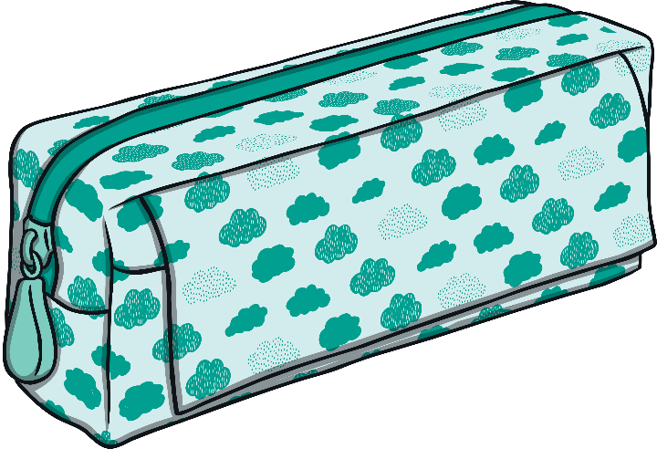
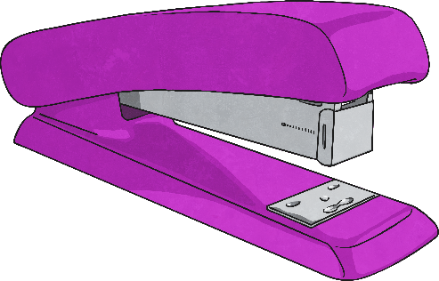

Measure and compare the length of the objects.
4
6
The stapler is paperclips.
The pencil case is paperclips.
shorter
The stapler is than the pencil case.

Slide 5

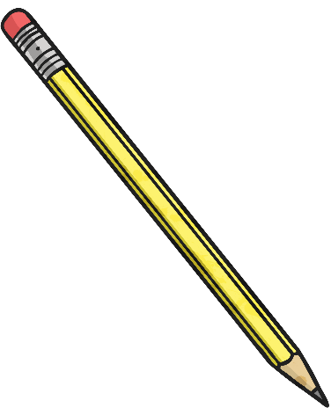

Measure and compare the length of the objects.
The pencil is
interlocking cubes.
The book is
interlocking cubes.
10
12
longer
The book is than the pencil case.

Slide 6


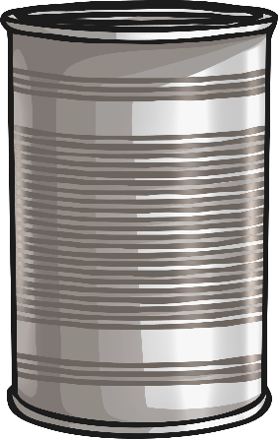
Measure and compare the length of the objects.
The drink bottle is
base ten blocks.
The pencil tin is
base ten blocks.
12
10
taller
The drink bottle is than the pencil tin.

Slide 7
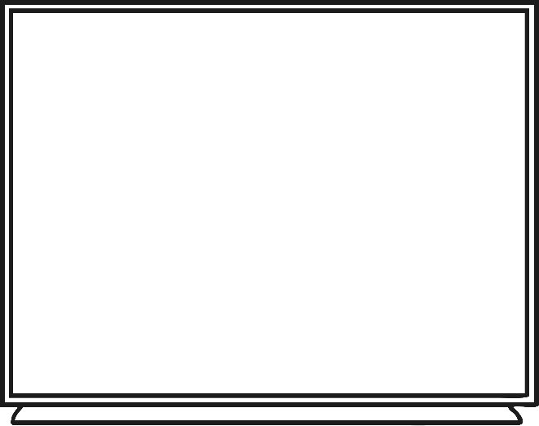
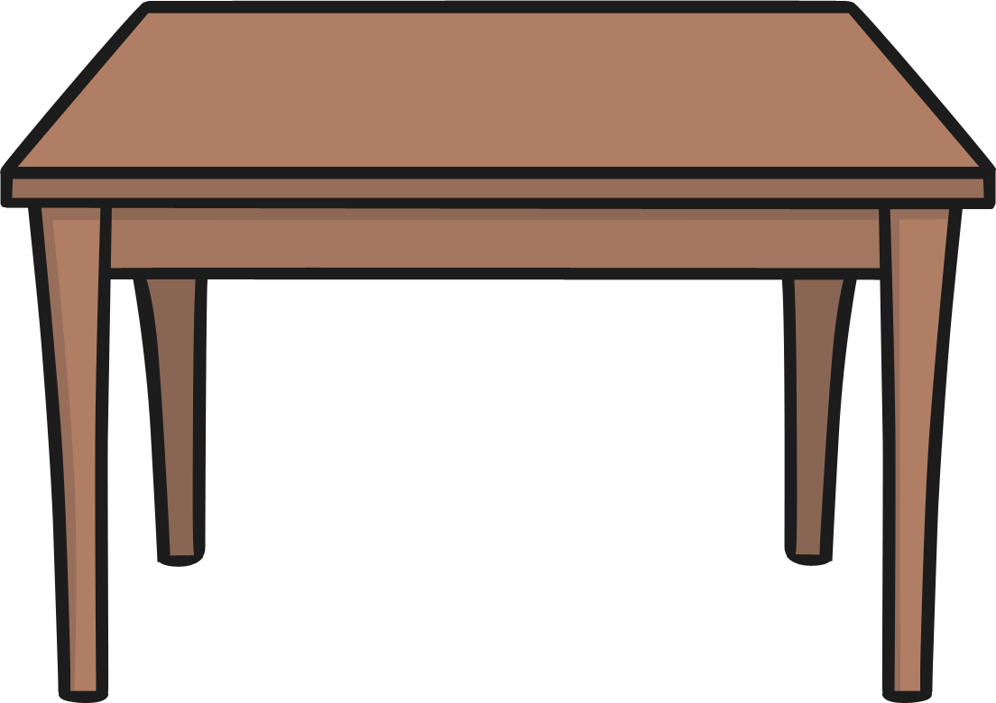
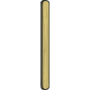
Measure and compare the length of the objects.
The desk is
paddle pop sticks.
The white board is
paddle pop sticks.
6
7
shorter
The desk is than the white board.

Slide 8
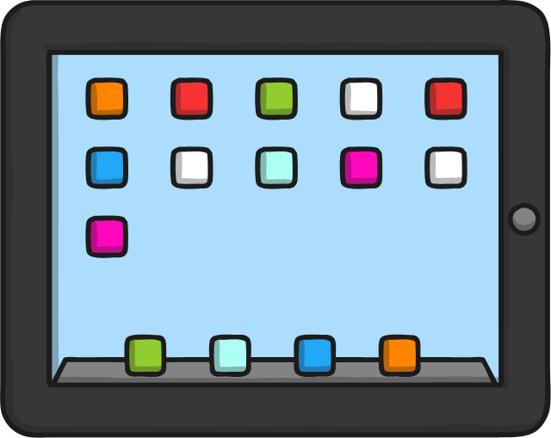
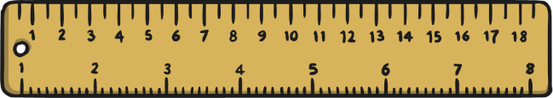
Measure and compare the length of the objects.
7
5
The ruler is paper clips.
The tablet is paperclips.
longer
The ruler is than the tablet.

Slide 9
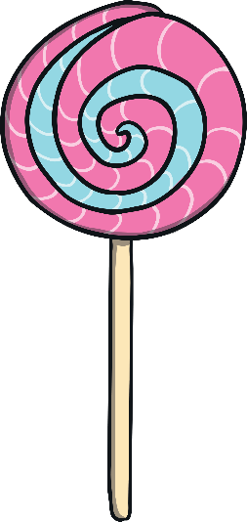

Measure and compare the height of the objects.
The lollipop is
base ten blocks.
The mug is
base ten blocks.
10
10
equal height
The lollipop and the mug are .

Slide 10
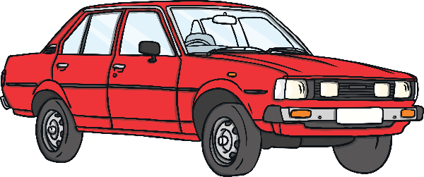

Measure and compare the length of the objects.
The toy car is
paper clips.
The pencil is
paper clips.
4
4
equal length
The toy car and the pencil are .

Slide 11
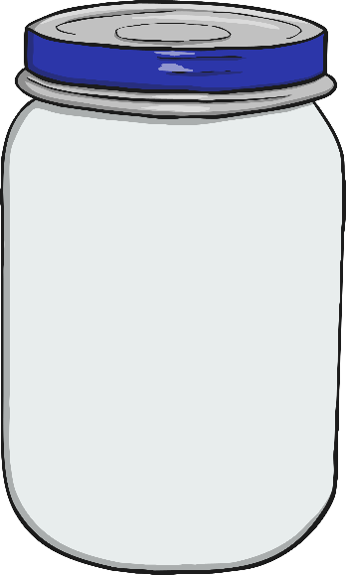


Measure and compare the length of the objects.
6
8
The glue stick is
base ten blocks.
The mug is base ten blocks.
The jar is base ten blocks.
7
shortest
The mug is the .
tallest
The jar is the .

