Slide 1
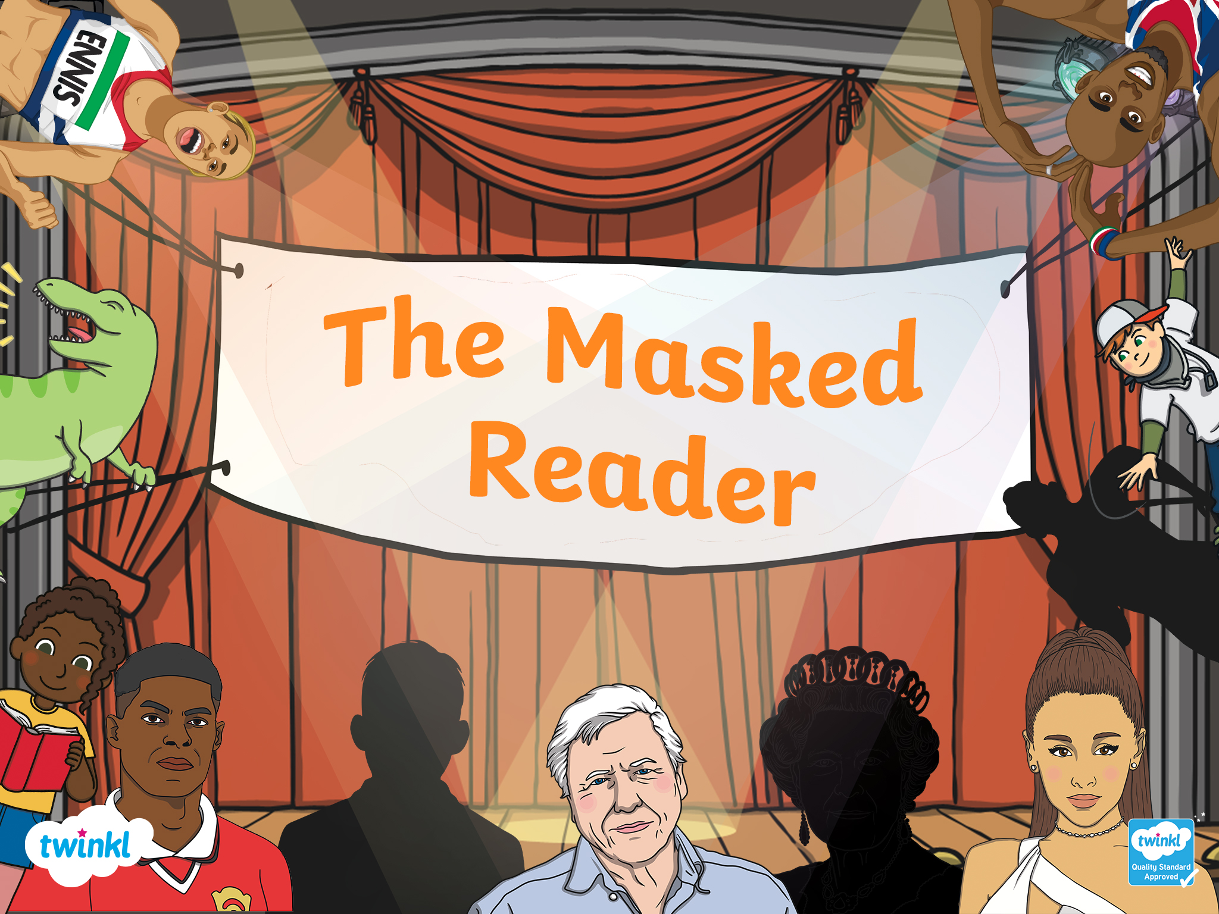

Slide 2

Who Is the Masked Reader?
Can you work out who the celebrity masked reader is and what book they are reading?
Solve three clues to work out who the masked reader is.
Solve three more clues to find out what book they’re reading.

Slide 3





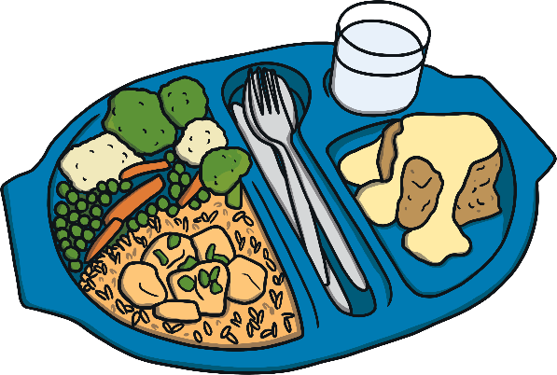
Masked Reader 1
Clue 1: He's a professional football player.
Clue 2: He plays football for Manchester United.
Clue 3: He is a campaigner for free school meals.
Click to find out who it is..

Slide 4

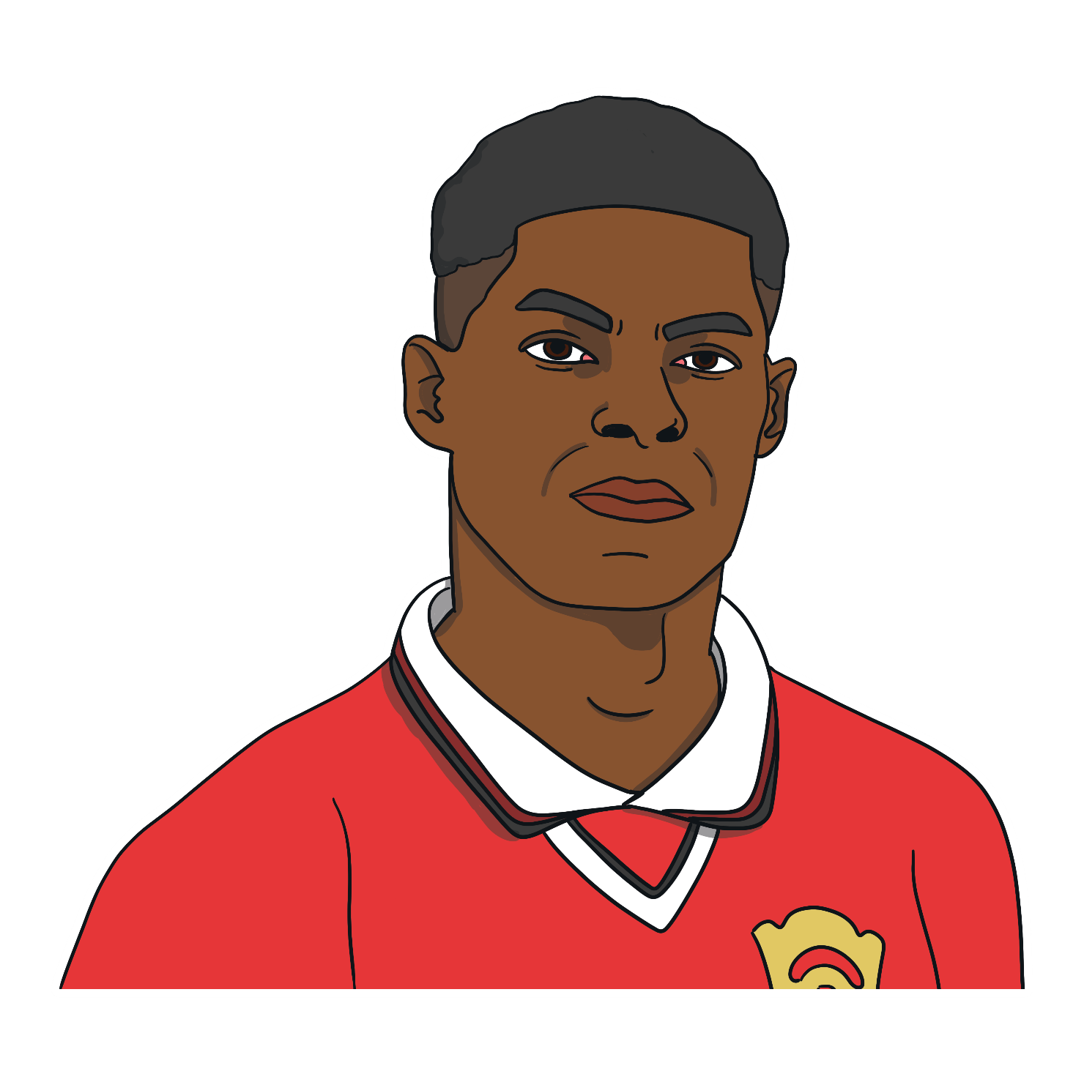
It’s
Marcus Rashford!

Slide 5


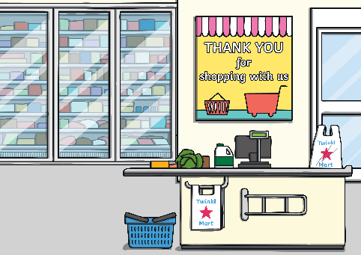
Can you guess what Marcus is reading?
Clue 1: The story features lots of vegetables.
Clue 2: One green vegetable is very evil.
Clue 3: The story takes place in a supermarket.
Click to find out what the book is.

Slide 6

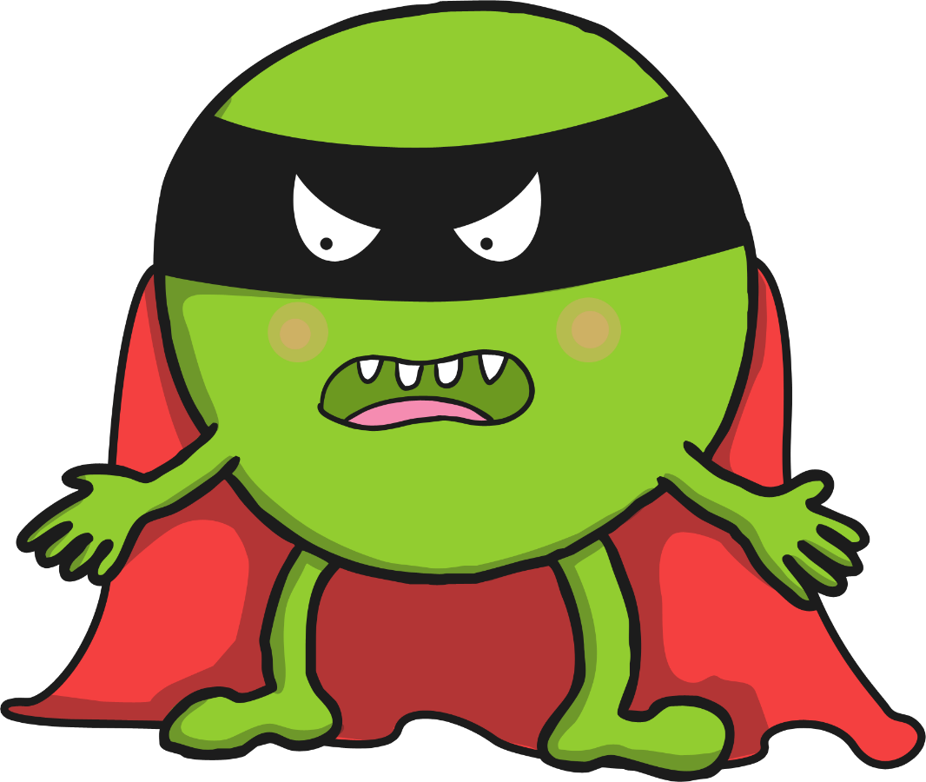
Marcus is reading ‘Supertato’ by Sue Hendra and Paul Linnet.

Slide 7

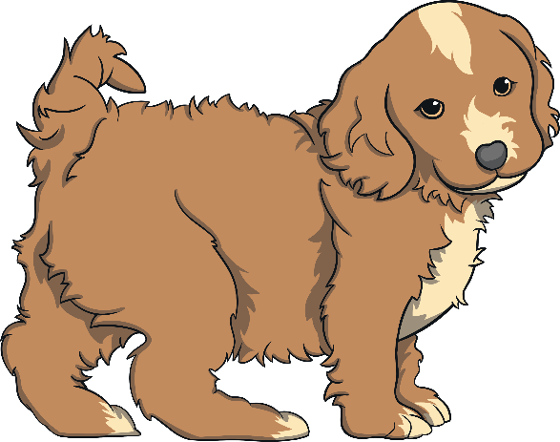


Masked Reader 2
Clue 1: She’s an American singer and actress.
Clue 2: She loves dogs and has nine as pets!
Clue 3: One of her albums is called ‘Yours Truly’.
Click to find out who it is..

Slide 8
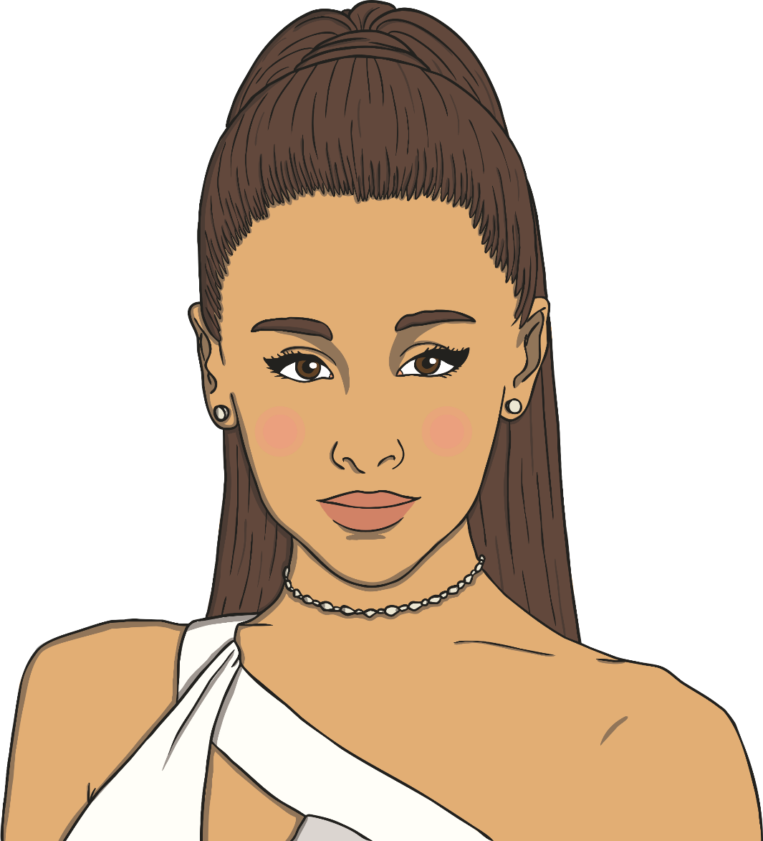
It’s
Ariana Grande!

Slide 9

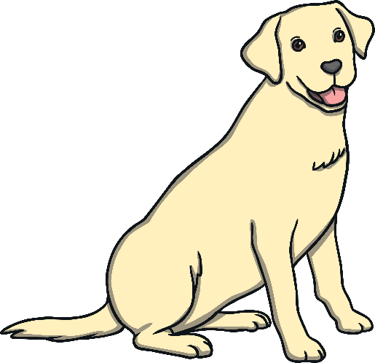
Can you guess what Ariana is reading?
Clue 1: The book is a rhyming book.
Clue 2: The story’s main character is a dog.
Clue 3: The story is about where all of the animals sit!
Click to find out what the book is.

Slide 10


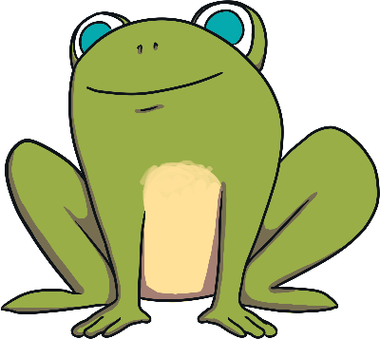
Ariana is reading ‘Oi Dog!’ by Kes Gray and Jim Field.

Slide 11


Masked Reader 3
Clue 1: He was born in 1926 and is over ninety years old.
Clue 2: He has has been knighted by the Queen.
Clue 3: He is famous for presenting natural history TV programmes, including Planet Earth.
Click to find out who it is..

Slide 12
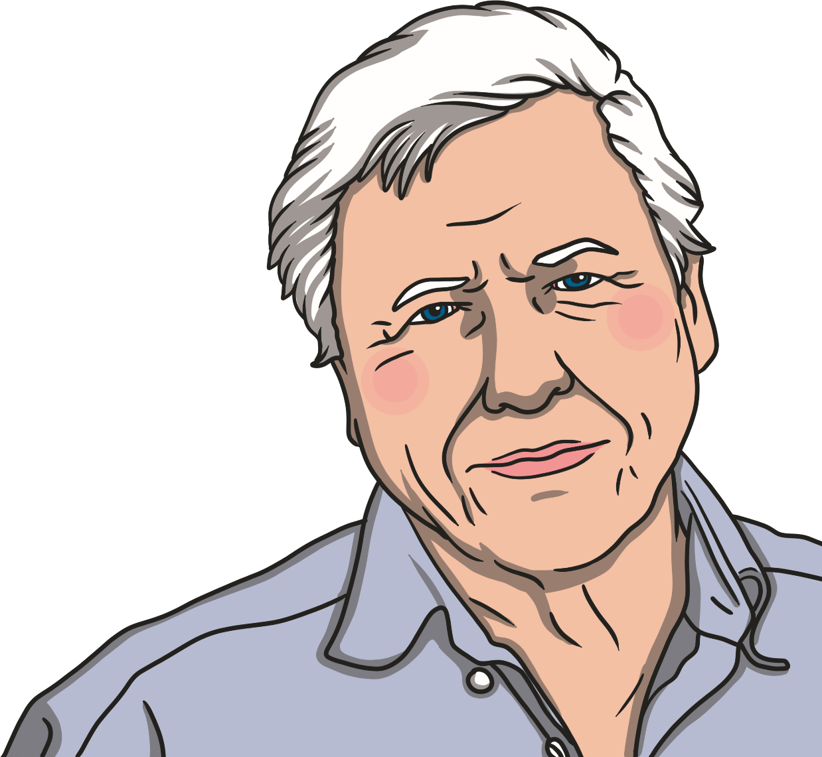
It’s
Sir David Attenborough!

Slide 13
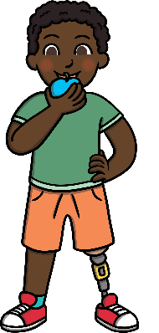
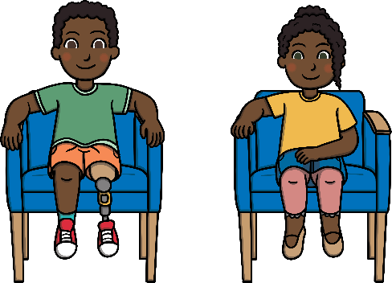


Can you guess what Sir David is reading?
Clue 1: The book is about three siblings.
Clue 2: The characters in the book are flying creatures with feathers.
Clue 3: The smallest character in the book wants its mummy.
Click to find out what the book is.

Slide 14


Sir David is reading ‘Owl Babies’ by Martin Waddell.

Slide 15

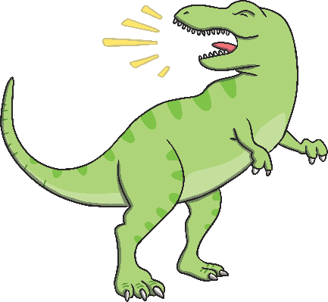

Masked Reader 4
Clue 1: He is a famous athlete and has won four olympic gold medals.
Clue 2: Has has been knighted by the Queen.
Clue 3: He has written a children’s book, with Kes Grey, called ‘Go Mo Go: Dinosaur Dash!’
Click to find out who it is..

Slide 16
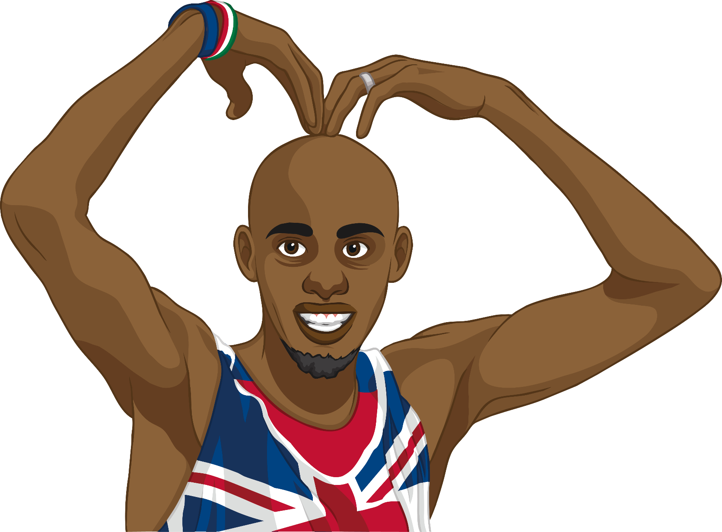
It’s
Sir Mo Farah!

Slide 17
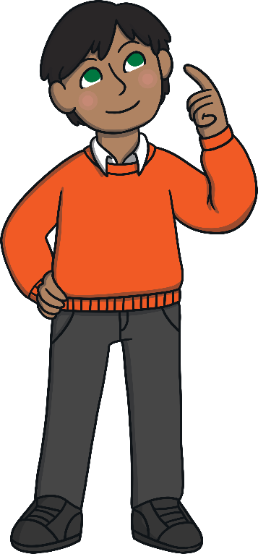


Can you guess what Sir Mo is reading?
Clue 1: The book is about a boy on his first day at school.
Clue 2: The boy has a bucket with some toy creatures in it.
Clue 3: The creatures are now extinct.
Click to find out what the book is.

Slide 18
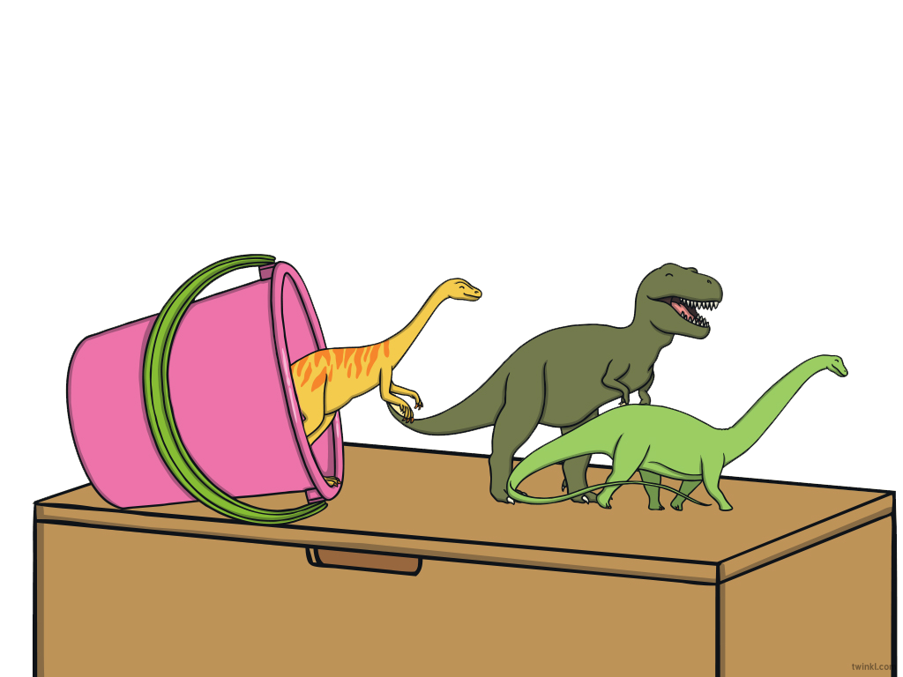

Sir Mo is reading ‘Harry and the Bucketful of Dinosaurs’ by Ian Whybrow.

Slide 19
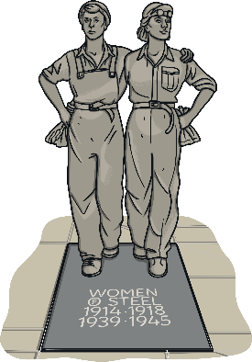
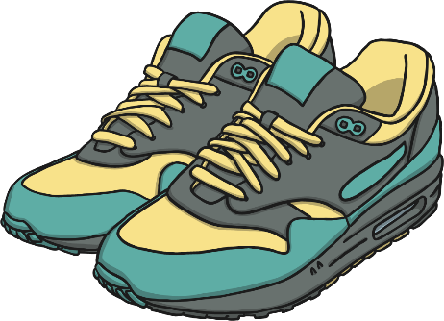

Masked Reader 5
Clue 1: She is a British athlete from Sheffield.
Clue 2: She is famous for taking part in heptathlons - competitions where you complete in seven sporting events.
Clue 3: She won a gold medal at the 2012 London Olympics.
Click to find out who it is..

Slide 20
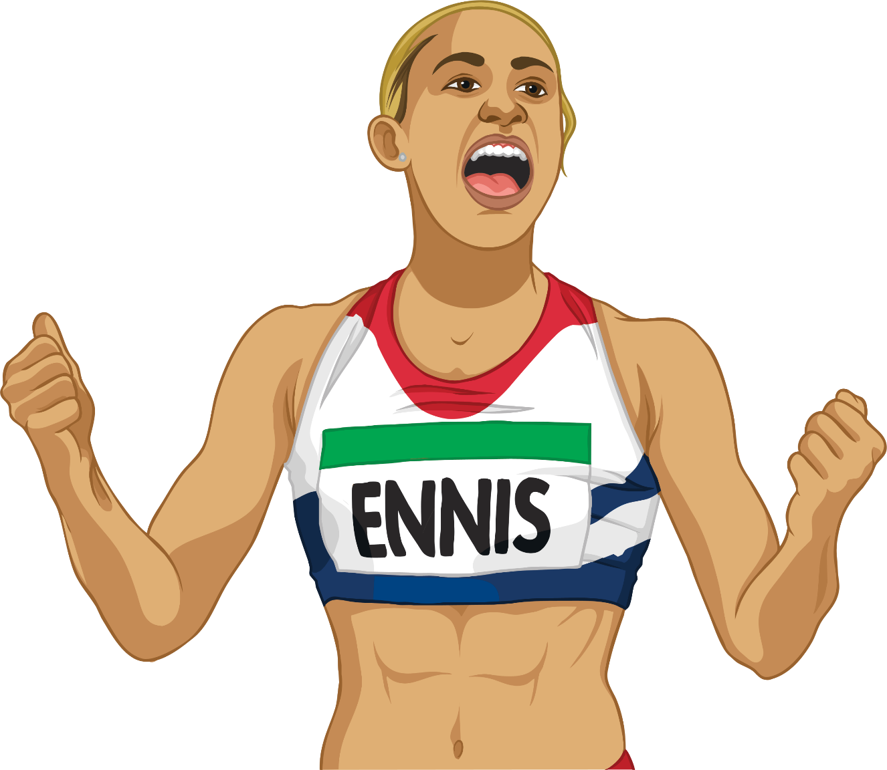
It’s
Jessica Ennis-Hill!

Slide 21


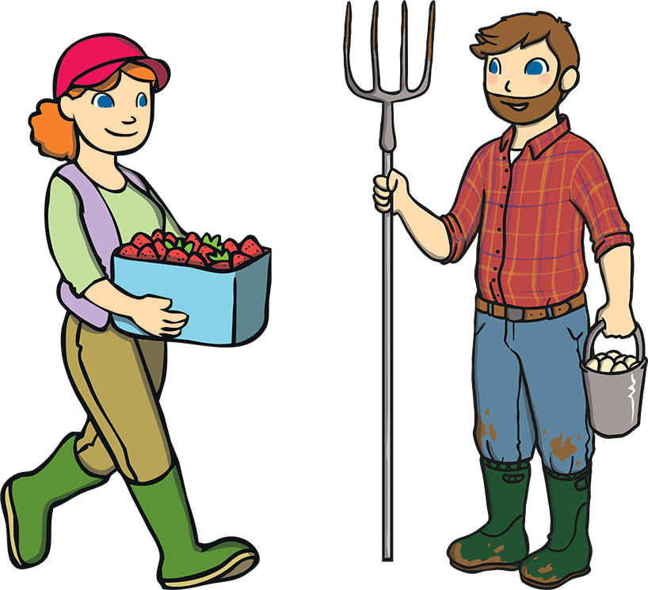
Can you guess what Jessica is reading?
Clue 1: The book is set on a farm.
Clue 2: It features a feathered creature who lays eggs.
Clue 3: The main character goes for a walk around the farm.
Click to find out what the book is.

Slide 22
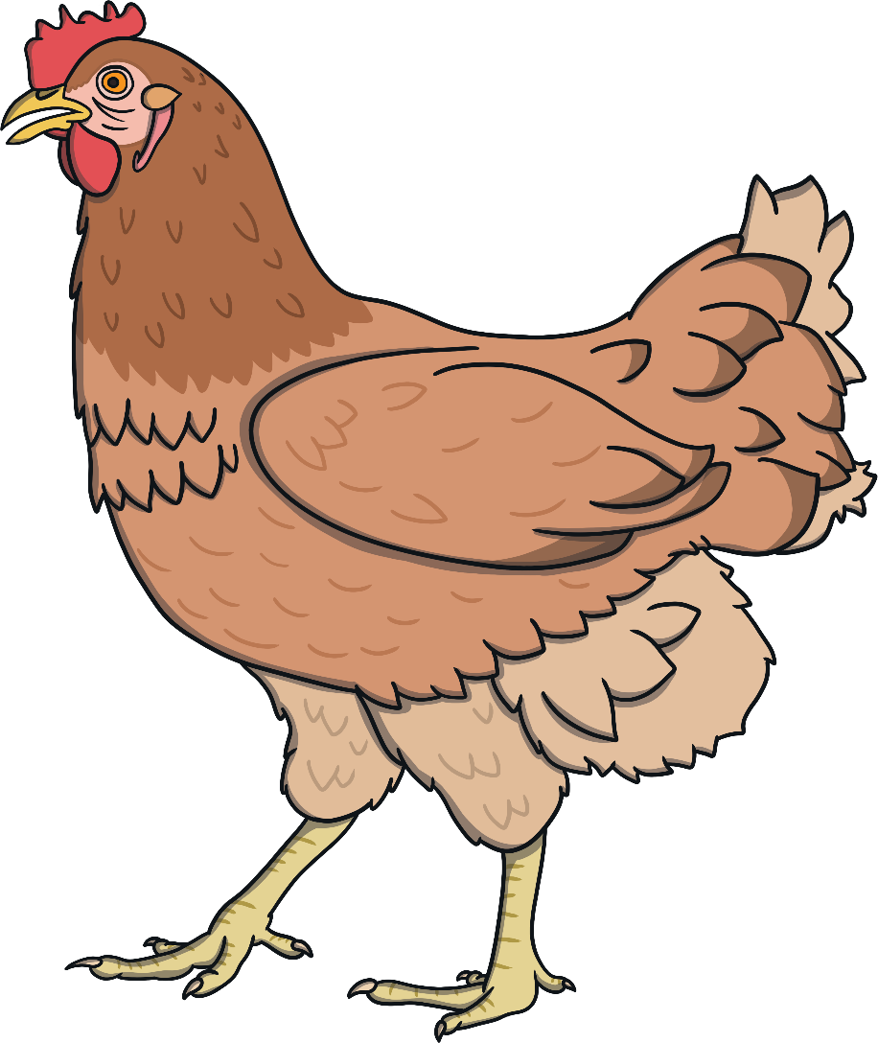
Jessica is reading ‘Rosie’s Walk’ by Pat Hutchins.

Slide 23
Now It’s Your Turn!
Think of your own masked reader (this could be a celebrity, or someone in your school).
Think of the book the masked reader is reading.
Think of three clues about the reader and three about the book.
Let your classmates try to guess who your masked reader is and what they are reading.

