Slide 2
The Engineer
George Stephenson was born on 9th June 1781 in Northumberland in the UK.
His father worked in the coalmine and so did George.
He didn’t go to school but when he was 18 years old, George taught himself to read and write.

Slide 3
The First Steam Railway Locomotive
George worked at different coalmines (collieries) and was made ‘chief mechanic’ at Killingworth Colliery.
In 1814, George built a locomotive - a vehicle to run on a railway. He named it ‘Blücher’ and it was used to transport coal. This could travel at four miles per hour.
Over time, George made improvements to the steam system and increased the pulling power of the engine. He had made the first steam railway locomotive.
Killingworth Colliery
Did You Know…?
The Blücher was named after the Prussian general who led his army against Napoleon I in a number of battles.

Slide 4
The First Public Railway
In 1821, George was asked to be the engineer for the new railway being built, which would run from Stockton to Darlington. His son, Robert, worked with him.
Railroads were first built to transport coal around the country. However, in 1825, the Stockton to Darlington railway opened and it was the first railway for passengers. It could carry more than 450 people and travelled at 15mph.
Opening Day of the Stockton to Darlington Railway by Ron Embleton
Did You Know…?
Before locomotives were powered by steam, horses would pull rail cars along the tracks.

Slide 5
Another New Railway
In 1826, George was given the job of engineer for the Liverpool to Manchester railway because he had made such a success of the Stockton to Darlington railway.
Building this railway wasn’t so easy for George because he had to use land that belonged to farmers and landowners. He had to talk to them about how useful this new railway would be and convince them it was a good idea.

Slide 6
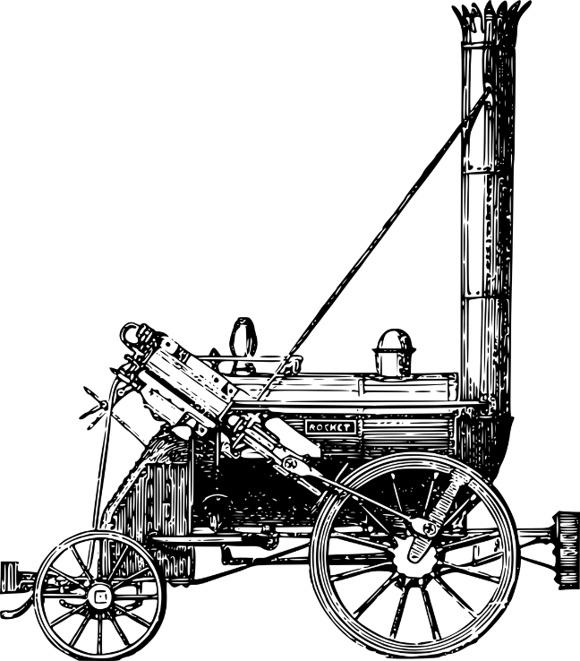
The Rocket
In October 1829, the railway’s owners held a competition to find out which locomotive was the best for pulling heavy loads over a long distance. The prize was £500.
It was a great event with thousands coming to watch. The scene was set at Rainhill near Liverpool and took place over nine days. George Stephenson was racing the locomotive named the ‘Rocket’ which had been designed and built by his son, Robert.
There were five locomotives in the competition but the Rocket was the clear winner, managing to get up to a speed of 30mph.

Slide 7
Legacy
The Rocket was so successful it proved that railways could be very useful for business and people. This led to railways being built all over the country.
George was the engineer on most of these new railways.
George Stephenson died on 12th August 1848 in Chesterfield. His work left an important legacy which continues to this day.

