Slide 2
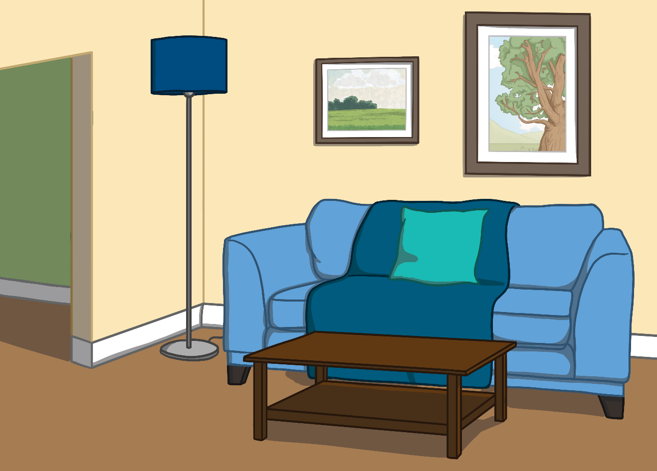
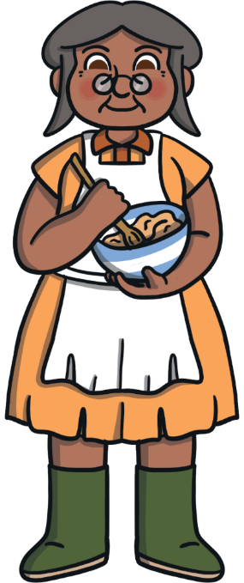
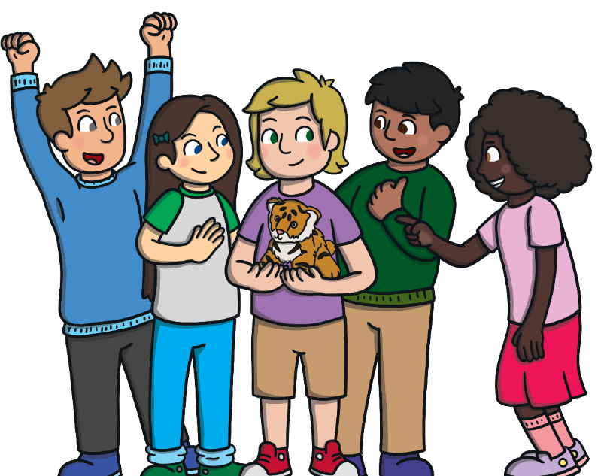
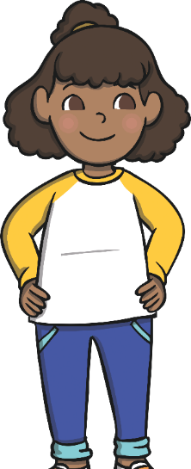

Once upon a time, there lived a woman who had seven children.
Next

Slide 3
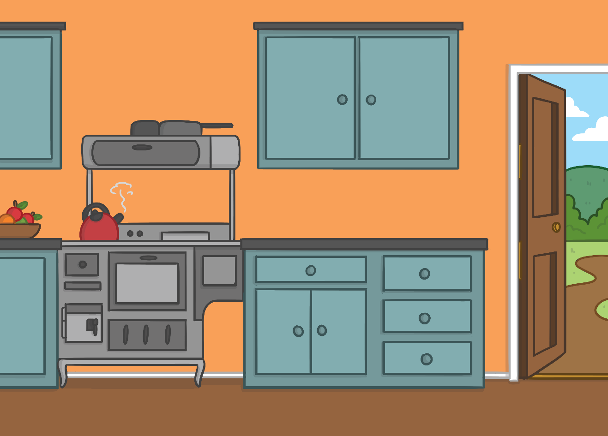
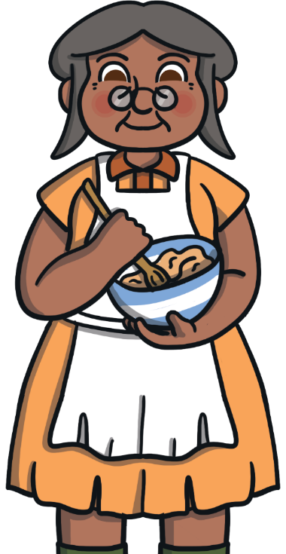
One day, the woman decided to make pancakes for breakfast.
Back
Next

Slide 4


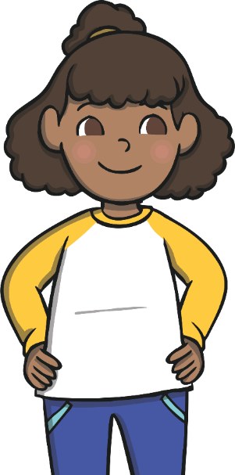
As she cooked the first pancake and the smell wafted across
the kitchen, the children licked their lips. Inside the frying pan,
the pancake could hear the children talking.
Can I taste the pancake first please, Mother?
Mmm, that pancake smells delicious!
The children’s tummies rumbled as the
pancake bubbled and cooked in the pan.
Back
Next

Slide 5

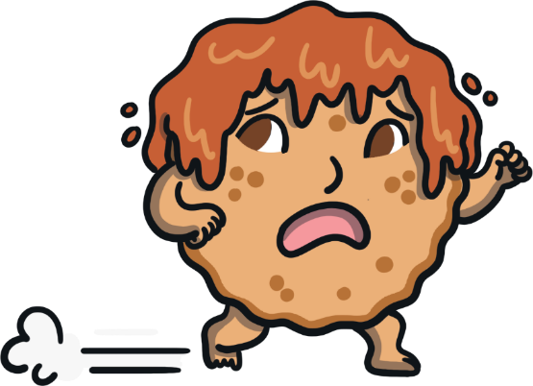
The mother flipped the frying pan and tossed the pancake over. As it cooked, the pancake became scared. It didn’t like the idea of being eaten, so it jumped right out of the pan and ran straight through the door!
Back
Next

Slide 6
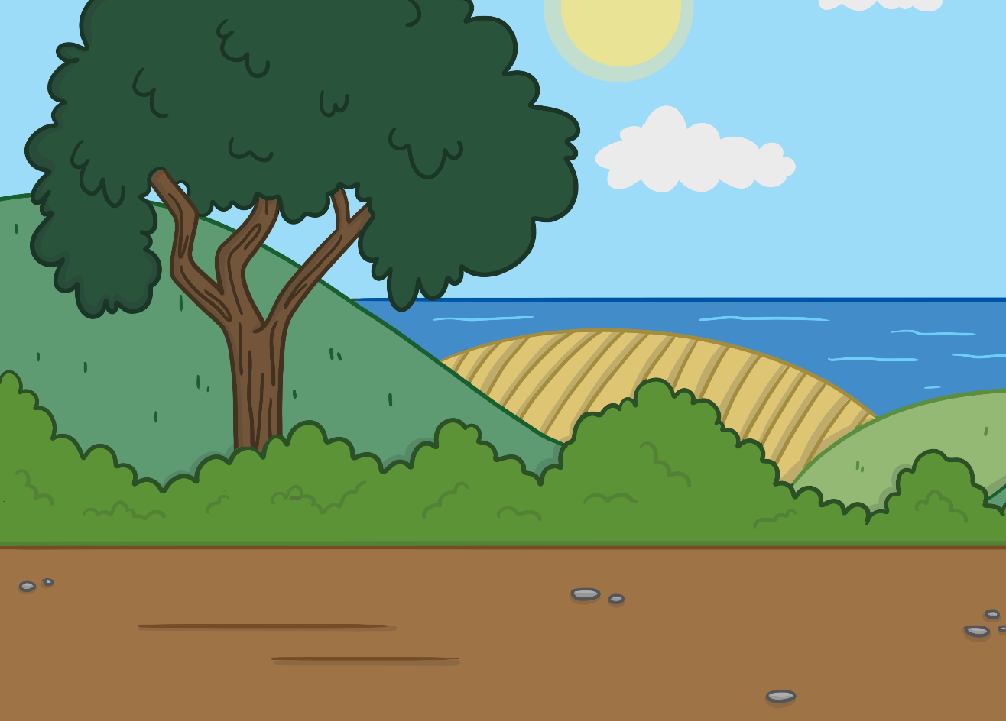
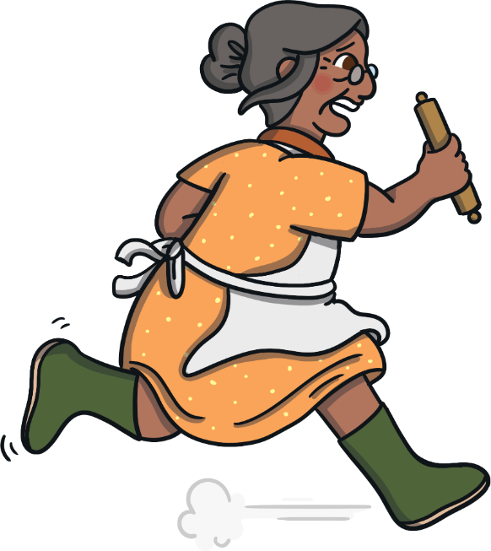
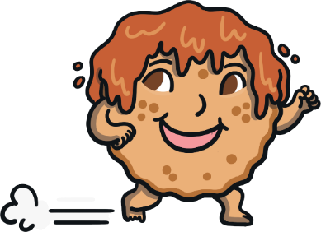
The family gave chase but they could not keep up with the pancake. “Come back!” they cried. “No, no, no! I’m too fast for you!” shouted the pancake and he quickly ran on.
Back
Next

Slide 7
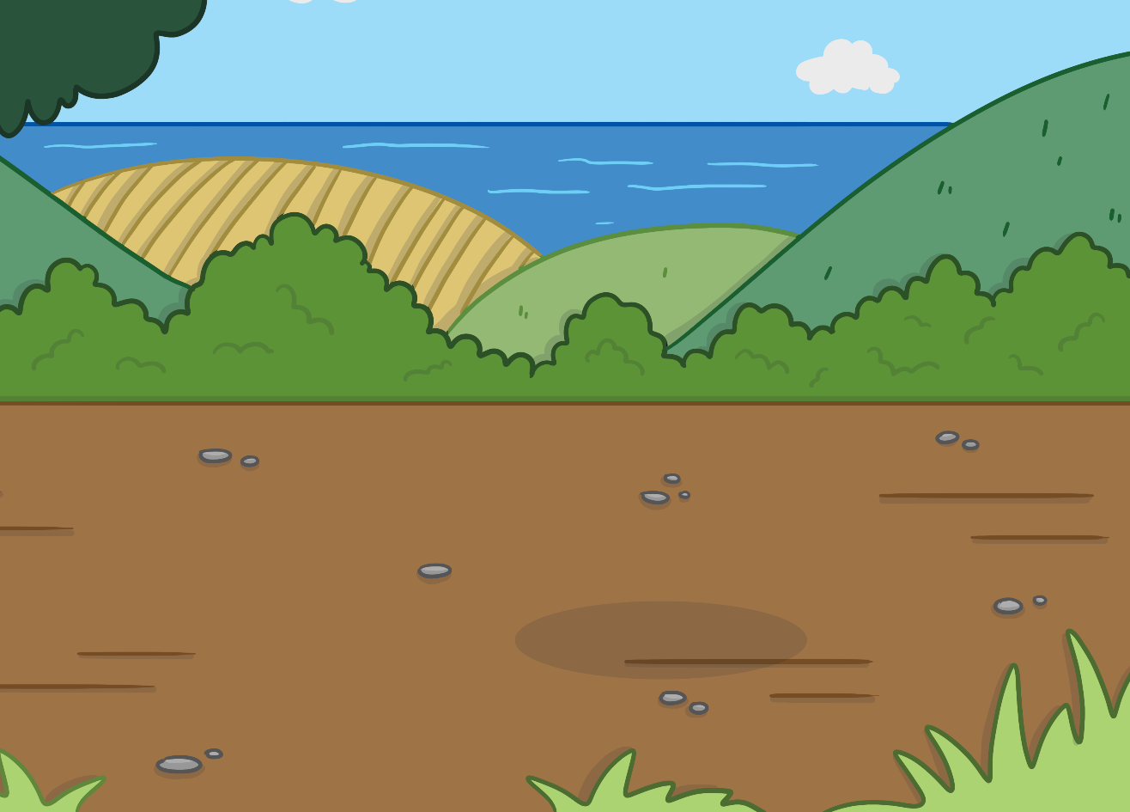
Soon, the pancake met a dog. “Hello, Mr Pancake,” said the dog. “Please stop running so I can eat you up!”
“No, no, no! I’m too fast for you!”
shouted the pancake and he quickly ran on.
Back
Next

Slide 8
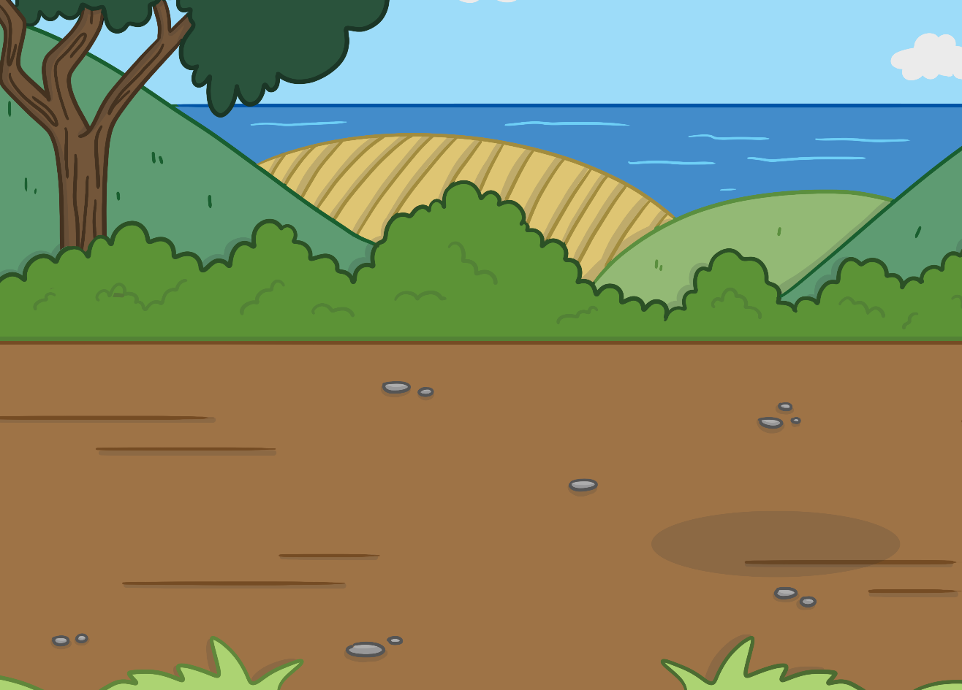
After that, the pancake met a rabbit. “Hello, Mr Pancake,” said the rabbit. “Please stop running so I can eat you up!”
“No, no, no! I’m too fast for you!”
shouted the pancake and he quickly ran on.
Back
Next

Slide 9
Around the bend, the pancake met a duck. “Hello, Mr Pancake,” said the duck. “Please stop running so I can eat you up!”
“No, no, no! I’m too fast for you!”
shouted the pancake and he quickly ran on.
Back
Next

Slide 10
A little while later, the pancake met a cat. “Hello, Mr Pancake,” said the cat. “Please stop running so I can eat you up!”
“No, no, no! I’m too fast for you!”
shouted the pancake and he quickly ran on.
Back
Next

Slide 11
Then, the pancake met a goat. “Hello, Mr Pancake,” said the goat. “Please stop running so I can eat you up!”
“No, no, no! I’m too fast for you!”
shouted the pancake and he quickly ran on.
Back
Next

Slide 12
Down the lane, the pancake came across a fox. “Hello, Mr Pancake,” said the fox. “Please stop running so I can eat you up!”
“No, no, no! I’m too fast for you!”
shouted the pancake and he quickly ran on.
Back
Next

Slide 13
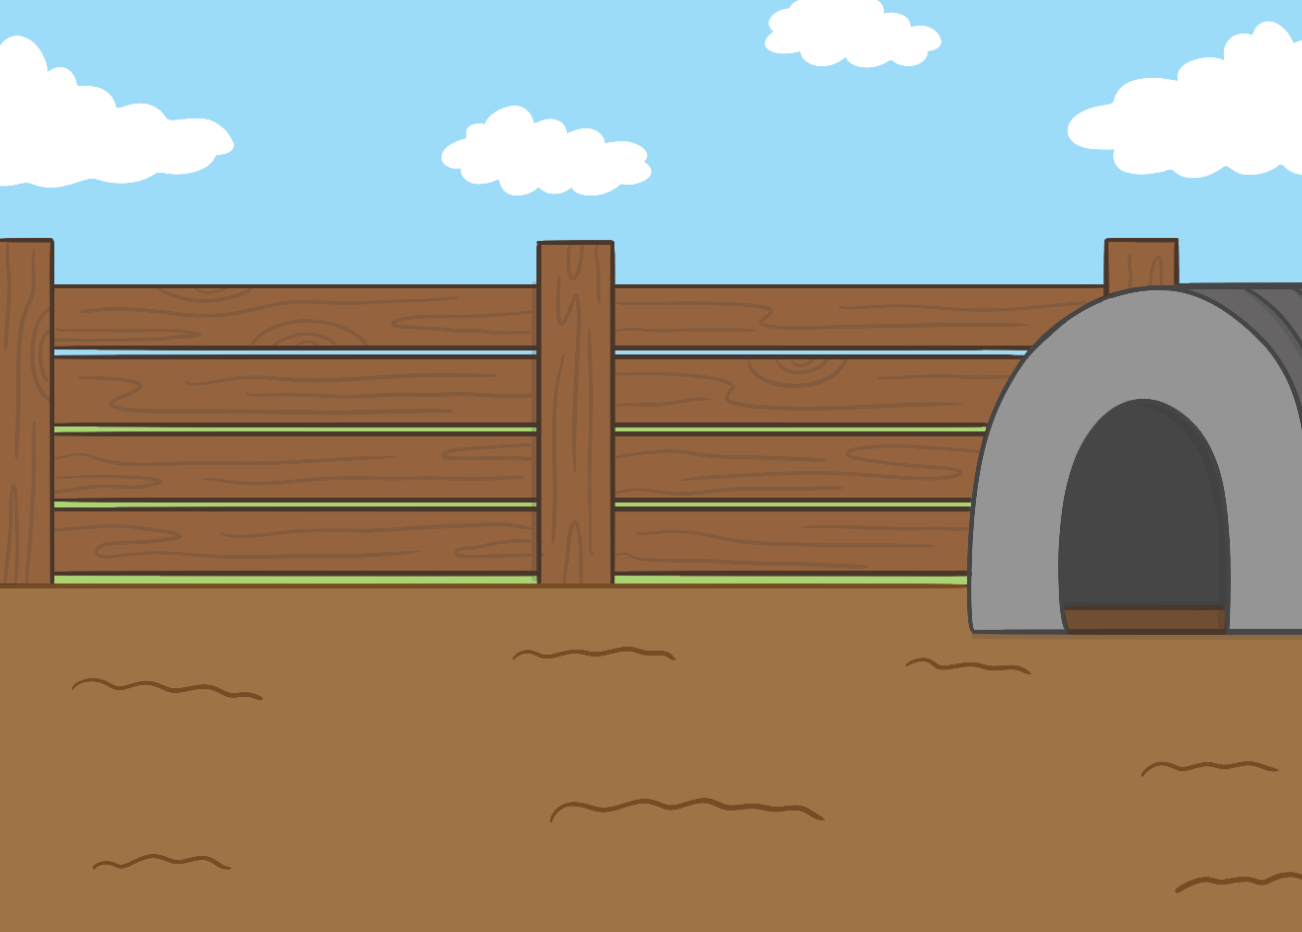
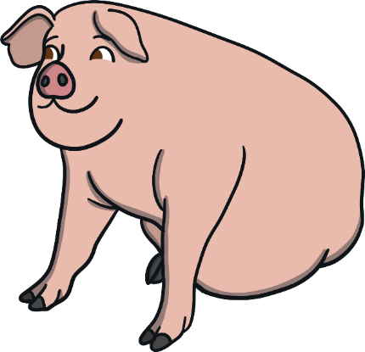
Suddenly, the pancake saw a pig pen. He ran forward for a closer look. “Hello little pancake, who are you trying to run away from?” asked the pig. “Everyone is chasing me, they want to eat me up!”
“Why don’t you come and hide inside my pigpen? I’ll protect you.”
“Thank you!” said the pancake.
Back
Next

Slide 14
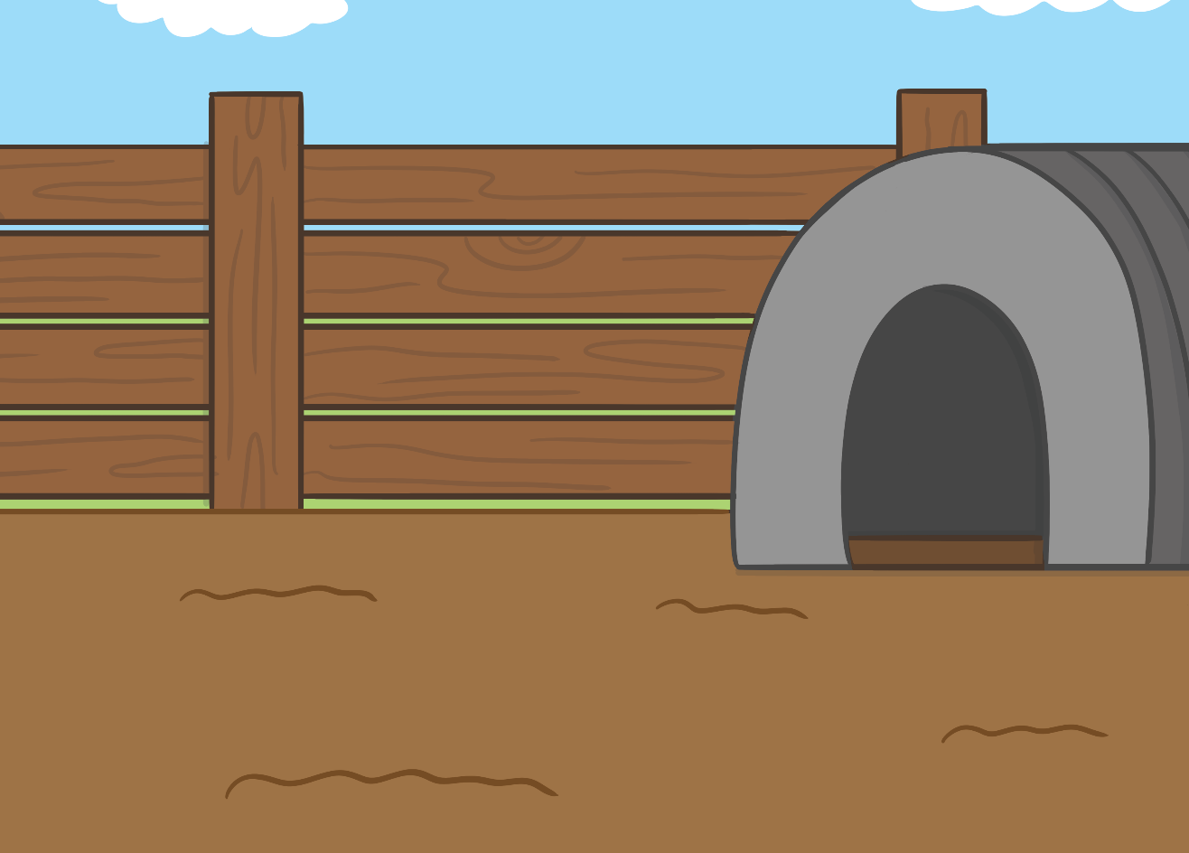
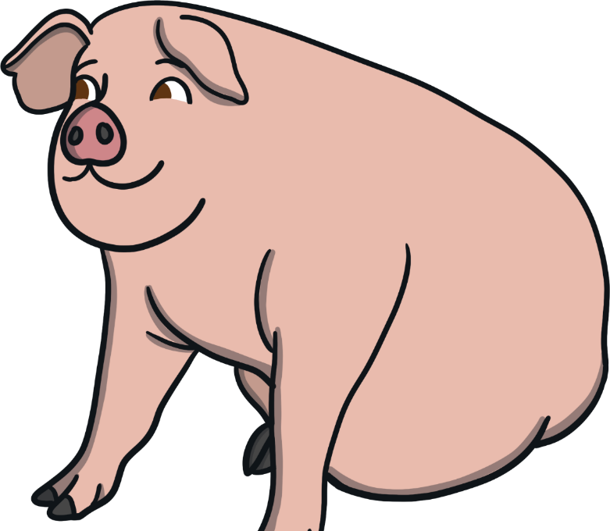
The pancake ran into the pigpen. As quick as a flash, the pig lifted the pancake with his snout, tossed it into the air and gobbled it up! That was the end of the runaway pancake.
Back
Next

