Slide 3
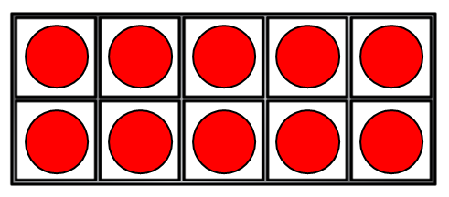
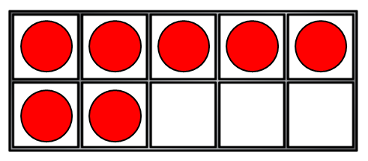
These are number bonds to ___
5 + 2 1 + 6 3 + 4
2) What symbol means “add” ?
3) Let’s count in 2s starting at 12
4) How many counters?
+

Slide 4
These are number bonds to ___
5 + 2 1 + 6 3 + 4
2) What symbol means “add” ?
3) Let’s count in 2s starting at 12
4) How many counters?
7
+
12, 14, 16, 18, 20…
+
17

Slide 6
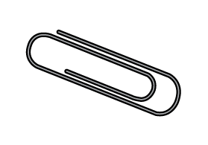
Have a think
This is like counting in 2s!
2, 4, 6, 8
How long is 4 paperclips?
8 cm

Slide 7
Have a think
5, 10, 15
How long is 3 pencils?
15 cm

Slide 8
Have a think
How long is 1 pencil and 1 paperclip?
5 + 2 =
7 cm

Slide 9
Have a go at question 1 on the worksheet

Slide 10
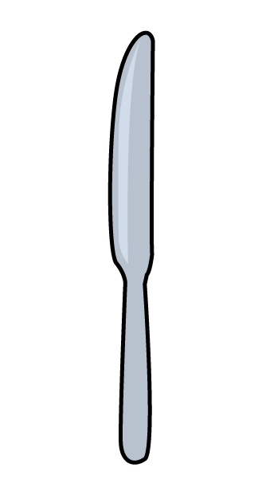
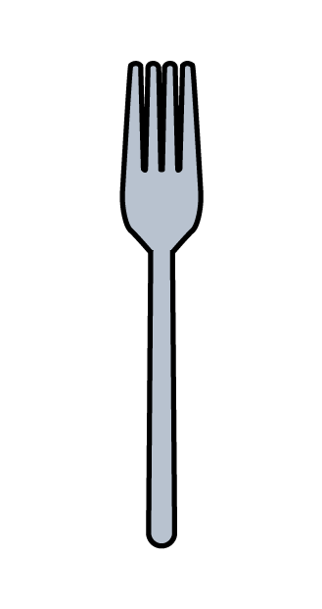
Adding lengths
Have a think
8 cm
6 cm
What is the total length of the
8 + 6 =
14 cm

Slide 11
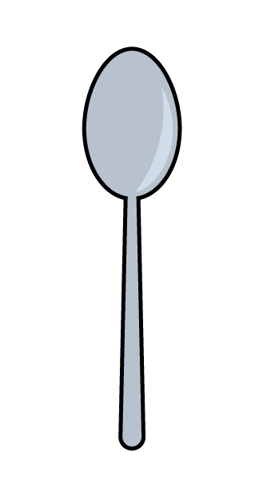
Adding lengths
Have a think
6 cm
8 cm
3 cm
What is the total length of the
3 + 8 =
11 cm

Slide 12
Adding lengths
Have a think
3 cm
8 cm
6 cm
What is the total length of 2
3 + 3 =
6 cm
2 is equal to 1

Slide 13
Adding lengths
Have a think
3 cm
8 cm
6 cm
What is the total length of 2
6 + 6 =
12 cm

Slide 14
Adding lengths
Have a think
3 cm
8 cm
6 cm
Which is longer?
6 + 6 =
12 cm
3 + 8 =
11 cm

Slide 15
Have a go at question 2 on the worksheet

