Slide 2
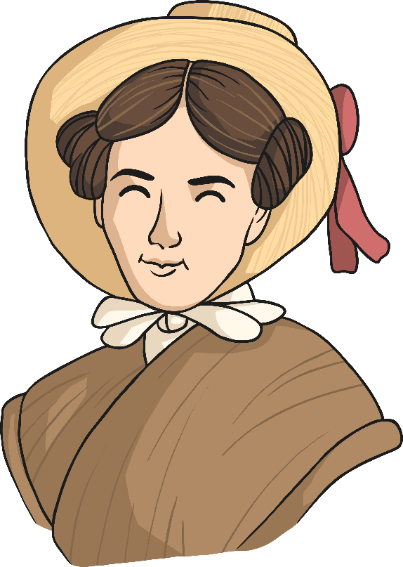
Early Life
Grace Darling was born on 24th November, 1815, in Bamburgh, Northumberland.
Grace’s father, William Darling, was a lighthouse keeper on Brownsman Island. This island was one of the largest of the Farne Islands, off the north coast of Northumberland.

Slide 3
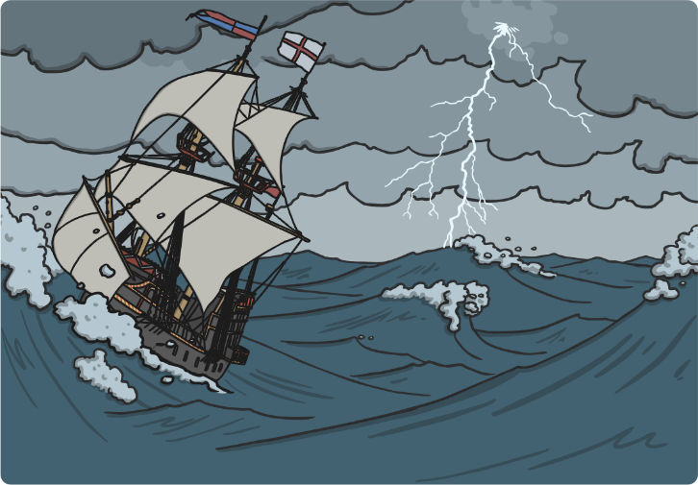
Early Life
Grace lived on Brownsman Island with her family. No trees grew on the island, but the coarse grass allowed them to keep grazing animals such as goats and sheep.
When the weather was pleasant enough to go into the water that surrounded the island, Grace and her siblings would row out in their boat and explore the cliffs and caves. Although the water was sometimes dangerous, Grace was strong and knowledgeable about the area.
Occasionally, passing ships and boats would crash into the rocks and William Darling and his sons would go to rescue the sailors and collect salvage where possible.

Slide 4
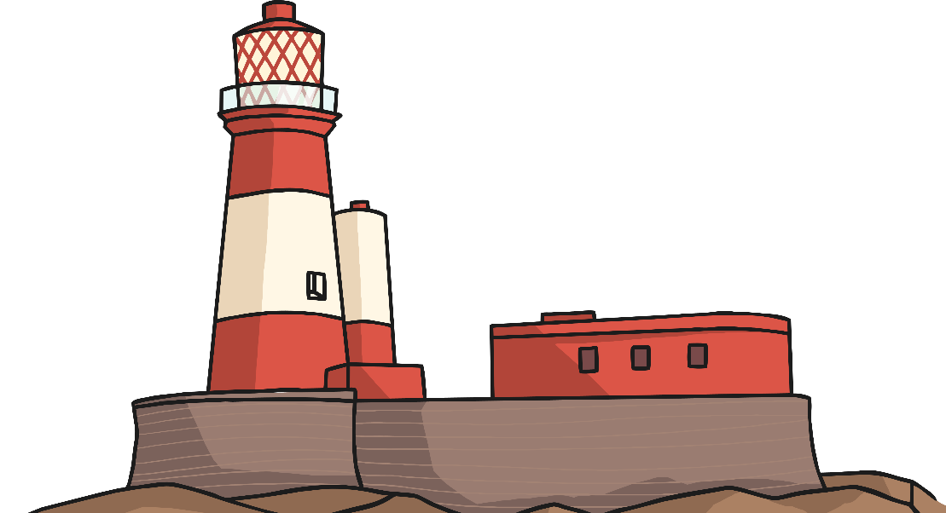
Moving to Longstone
Although the lighthouse at Brownsman Island was vital for boats shipping to the Farne islands, it was unable to warn vessels of the dangers at Knavestone, Longstone and Harcars. William appealed to Trinity House to address the problem, and so a lighthouse was built on Longstone.
The family moved to Longstone in 1825, when Grace was ten. Most of Grace’s older brothers and sisters left and the land around the lighthouse was barren and deserted. It was a lonely place, and this is where Grace would live for the rest of her life.

Slide 5
Living in a Lighthouse
In the top of the lighthouse lantern, William taught his children how to recognise the different kinds of sea vessels, where they were heading and what they were shipping. He told them to keep an eye out for anything that looked unusual.
For a long time, Grace helped her mother with chores and was capable of running the lighthouse efficiently.
When Grace turned 15, her and her younger twin brothers were the only remaining children living at home. Because of this, Grace had to row back and forth between the islands to fetch crops and tend to the livestock if her father was busy.
Grace became her father’s assistant and was capable of maintaining the lantern, mending fishing nets and keeping a watch out for vessels in danger.

Slide 6
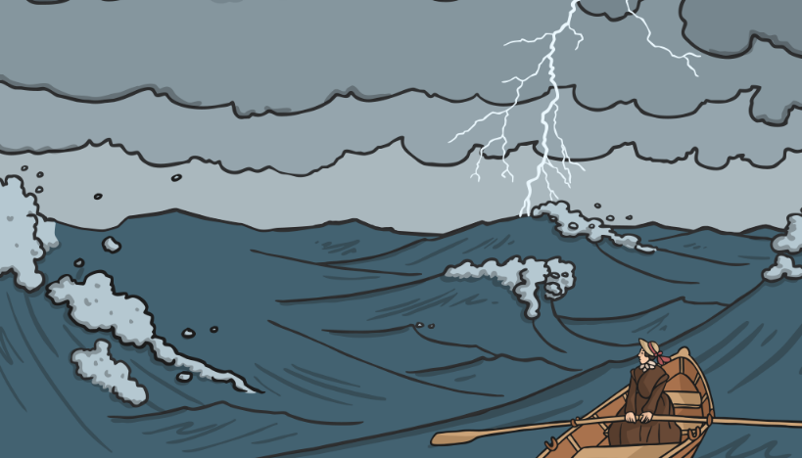
The Rescue
On 7th September 1838, the paddle steamer SS Forfarshire was travelling from Hull to Dundee carrying 60 passengers.
It was a stormy night and the Forfarshire was having trouble with its engine boilers, when suddenly disaster struck, and it hit the rocks off the coast of the Farne Islands.
Almost all 60 passengers had died in the accident, except for 4 passengers and 5 crew members who had clung to nearby rocks and waited to be rescued. 9 crew members and one passenger also escaped in a lifeboat.

Slide 7
The Rescue
As morning drew closer, the survivors were still clinging to the rocks. William and Grace Darling decided to row out to rescue them.
William climbed the rocks to reach the sailors while Grace stayed in control of the boat. While the storm raged on, Grace fought hard to keep the boat away from the rocks while her father rescued the survivors.
William and Grace helped all of the survivors onto the boat, until all of them were safe.
They took the survivors back to the lighthouse, where they treated their injuries and looked after them for 3 days, until the storm had finally passed.

Slide 8
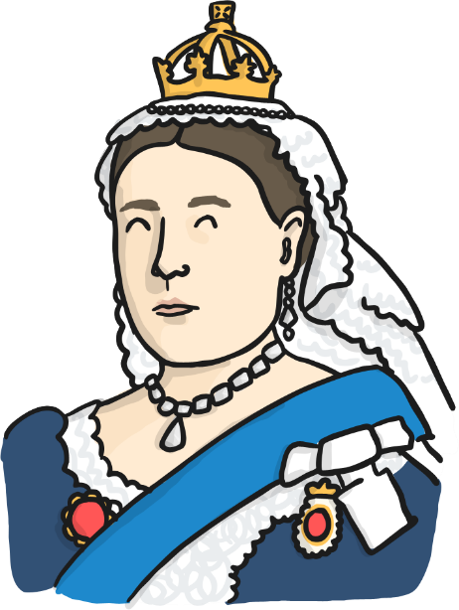
After the Rescue
After the rescue, Grace Darling became a heroine. The Victorian newspapers loved the story of her outstanding bravery, and after publishing her story, Grace became a celebrity.
Word had spread to Queen Victoria, and she received a personal letter from her with a reward of £50! She also got a lot of mail sent to her, requesting to visit her. She got money and gifts sent to her too.
In Victorian England, it was possible to buy plates, postcards and even boxes of chocolates with Grace’s face on them.
Grace sadly died in 1842 after the rescue aged 26. She is still remembered by many across the world today.

