Slide 2
Unscramble the Sentence
lady
over
tins.
The
knocked
the
The
lady
knocked
over
the
tins.
The lady knocked over the tins.
next

Slide 3
If your child can read the sentences independently, they can try and unscramble the sentence. If they find this tricky, read the scrambled sentence aloud and then ask if the sentence sounded right and how it could be changed to make sense.

Slide 4
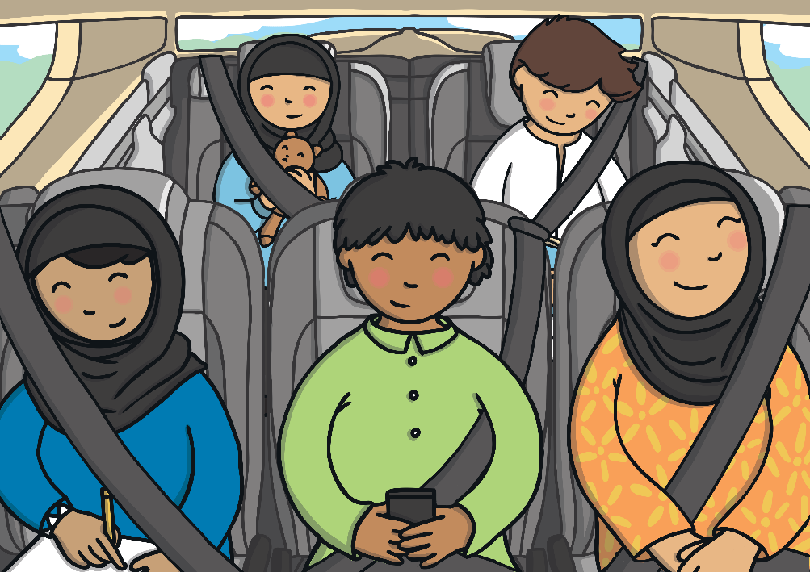
Unscramble the Sentence
people
in
car.
Five
sat
a
Click to reveal the answer
Five
people
sat
in
a
car.
Five people sat in a car.
back
next

Slide 5
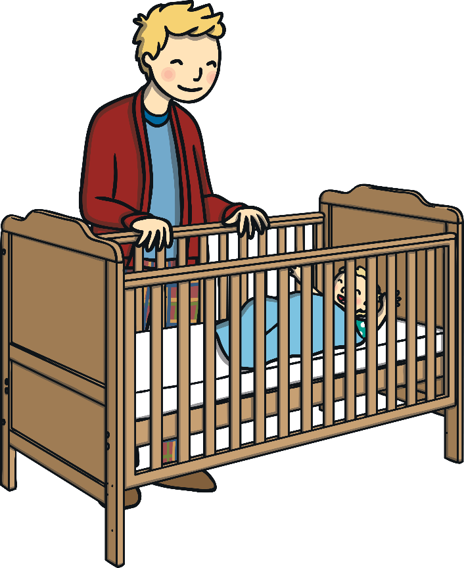
Unscramble the Sentence
checked
the
baby.
Dad
on
sleeping
Click to reveal the answer
Dad
checked
on
the
sleeping
baby.
Dad checked on the sleeping baby.
back
next

Slide 6
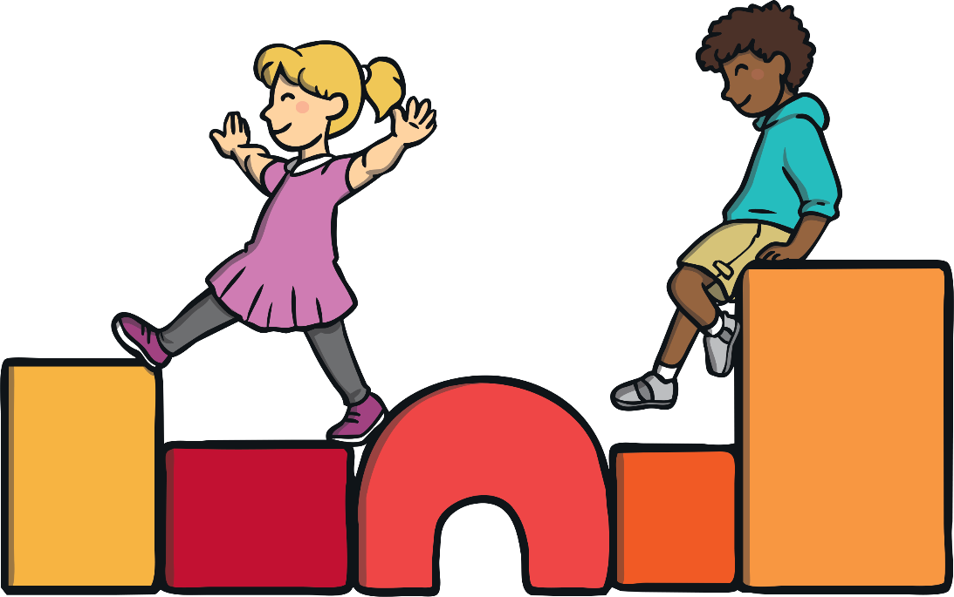
Unscramble the Sentence
children
on
blocks.
Two
climbed
the
Click to reveal the answer
Two
children
climbed
on
the
blocks.
Two children climbed on the blocks.
back
next

Slide 7
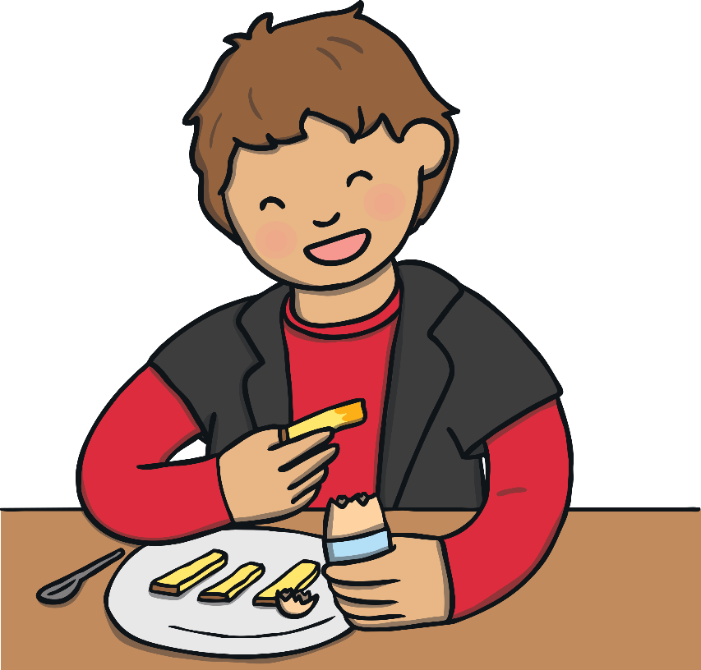
Unscramble the Sentence
ate
eggs
toast.
Sammy
some
on
Click to reveal the answer
Sammy
ate
some
eggs
on
toast.
Sammy ate some eggs and toast.
back
next

Slide 8
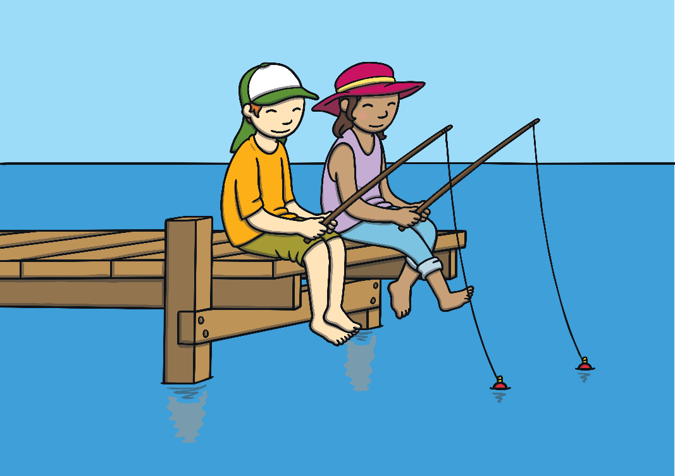
Unscramble the Sentence
children
in
sea.
Two
Click to reveal the answer
fished
the
Two
children
fished
in
the
sea.
Two children fished in the sea.
back
next

Slide 9
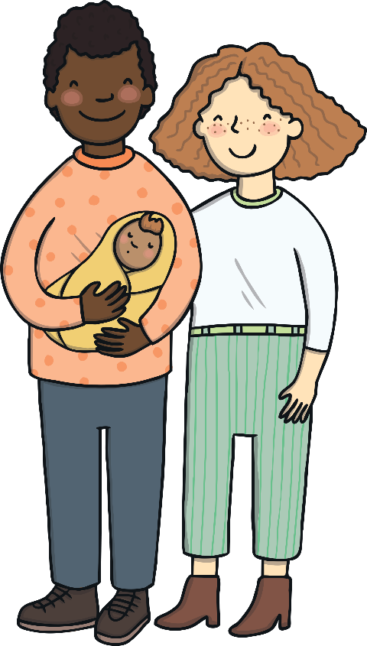
Unscramble the Sentence
and
held
Click to reveal the answer
new
Mum
Dad
their
Click again…
Baby.
Mum
and
Dad
held
their
new
baby.
Dad
and
Mum
held
their
new
baby.
Mum and Dad held their new baby.
back
next

Slide 10
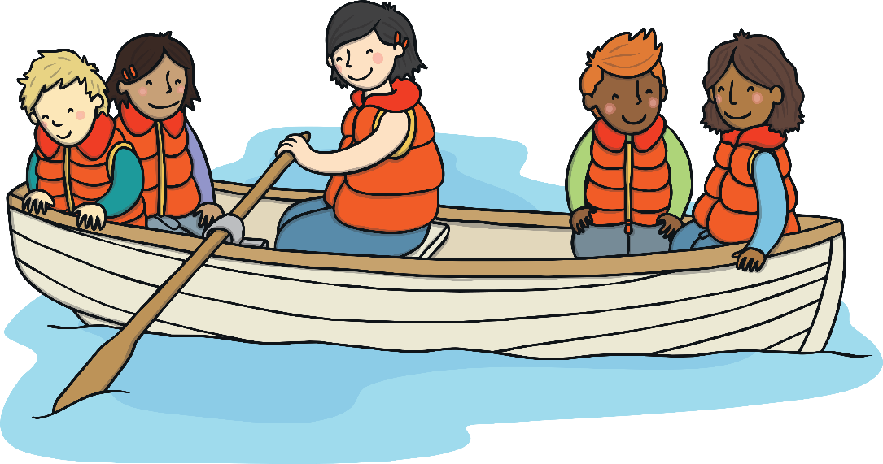
Unscramble the Sentence
children
across
big
The
sailed
the
Click to reveal the answer
pond.
The
children
sailed
across
the
big
pond.
The children sailed across the big pond.
back
next

Slide 11
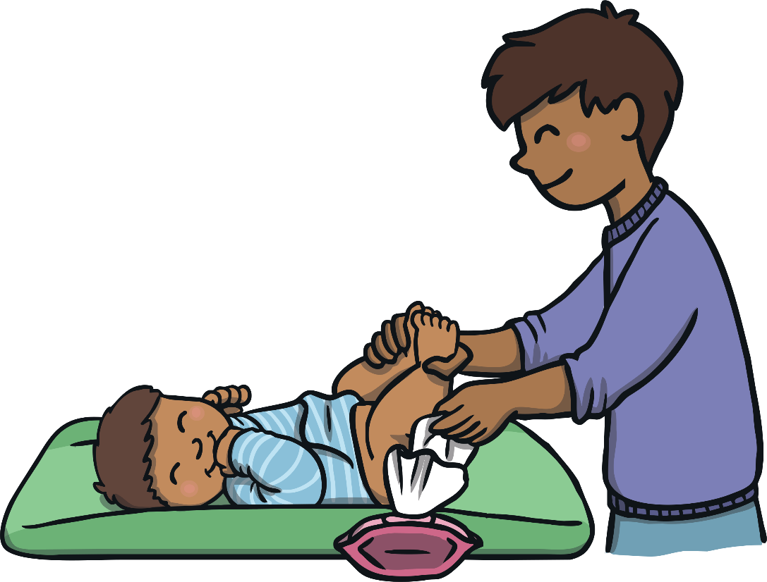
Unscramble the Sentence
Click to reveal the answer
changed
baby’s
nappy.
Charlie
the
dirty
Charlie
changed
the
baby’s
dirty
nappy.
Charlie changed the baby’s dirty nappy.
back
next

Slide 12
Unscramble the Sentence
waved
the
air.
feather
Click to reveal the answer
the
Pat
in
duster
Pat
waved
the
feather
duster
in
the
air.
Pat waved the feather duster in the air.
back

