Slide 1
Similes and Adjectives
WALT: Use similes and adjectives to improve our writing

Slide 2
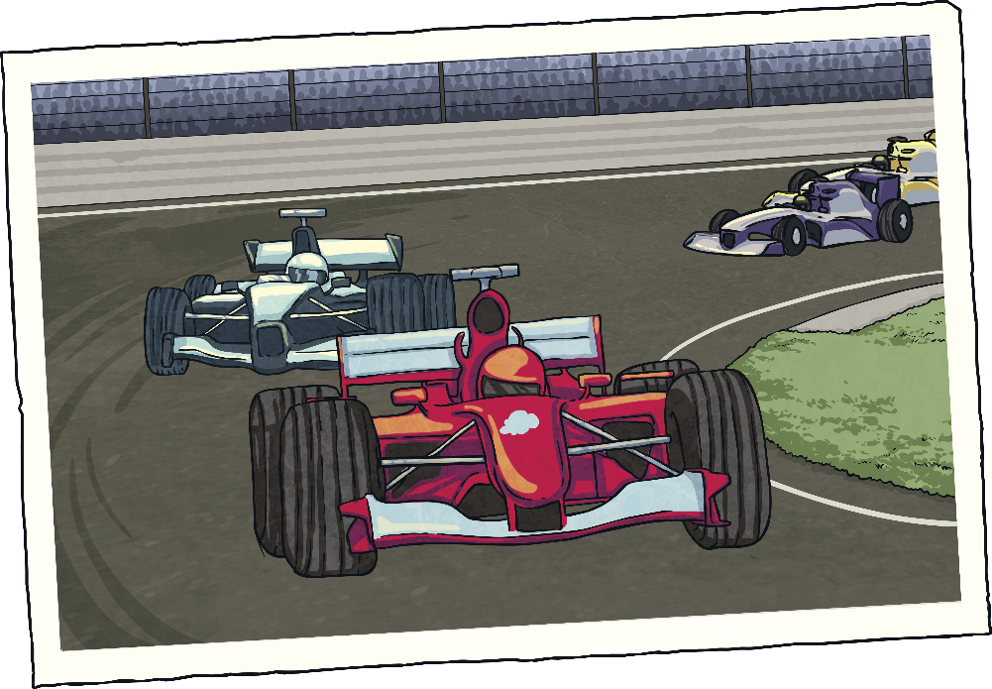
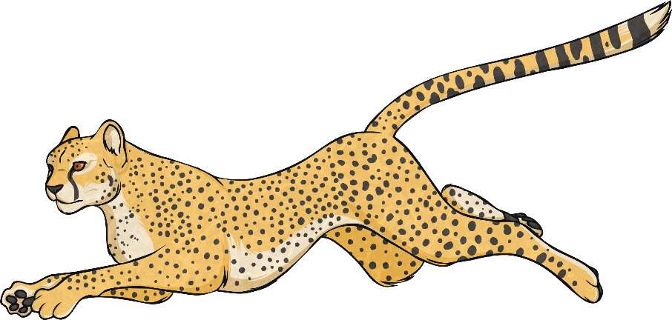
Simile Reminder
A simile is a way of describing something by comparing it to something else using ‘like’ or ‘as’.
Her eyes are like stars and her lips are like roses.
The car was as fast as a cheetah.

Slide 3
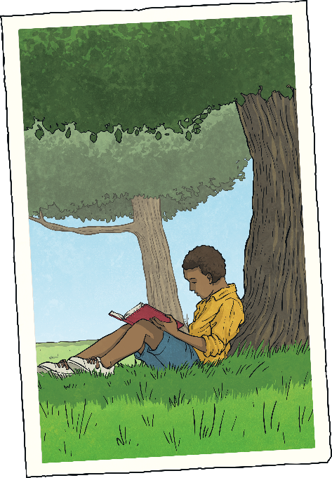
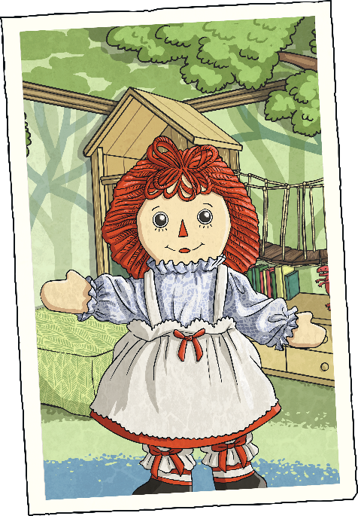
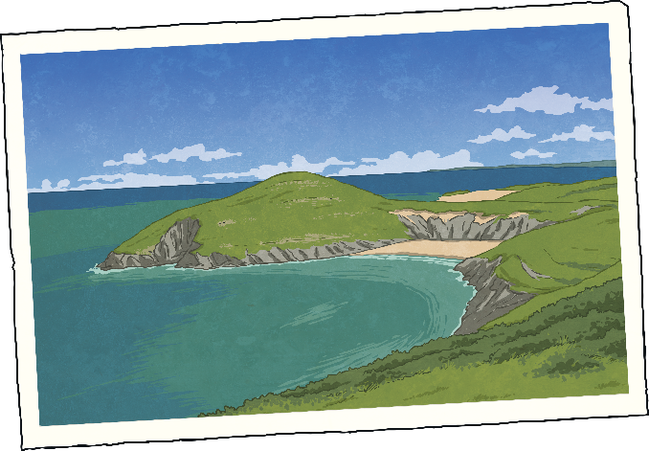
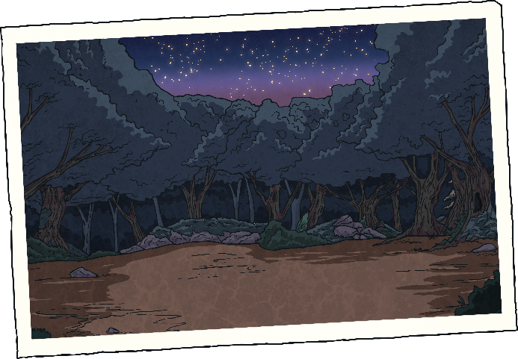
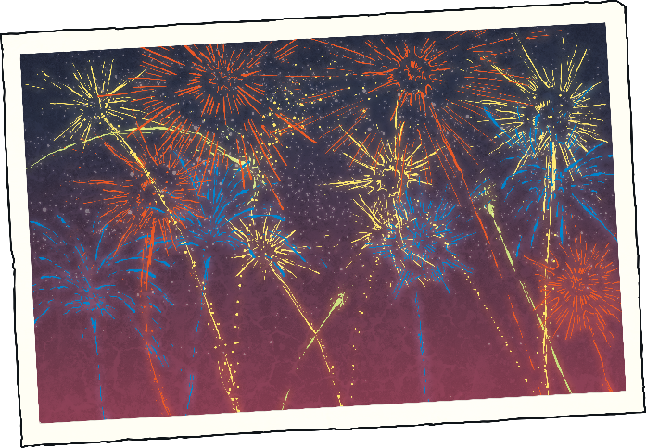
Now you try…
Finish the similes:
?
?
?
Greece was hot like…
The doll’s face was as smooth as…
The book was as exciting as…
?
?
The night was as black as…
The fireworks were colourful like…

Slide 4
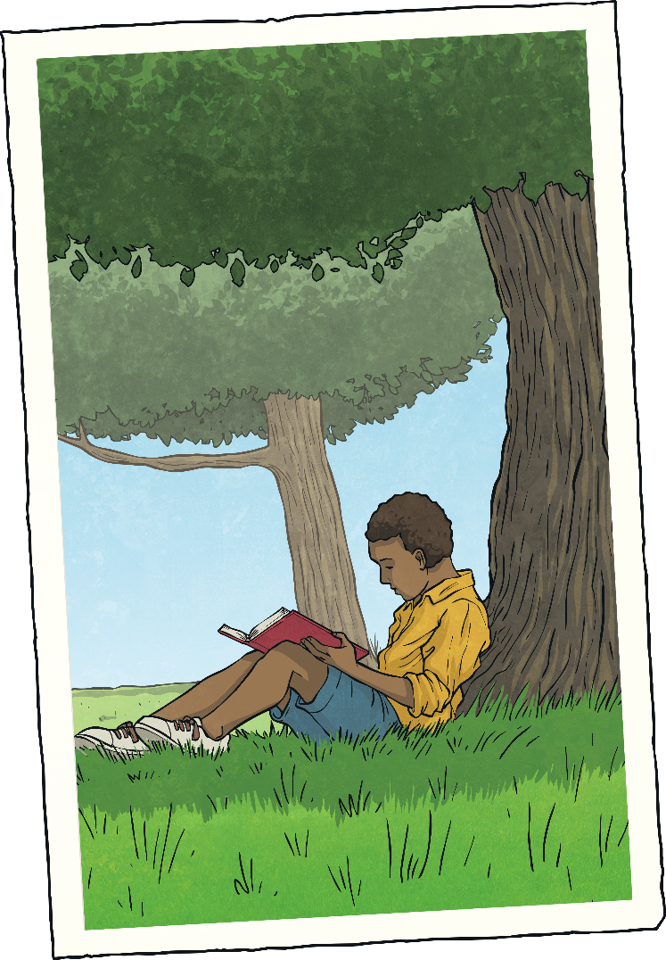
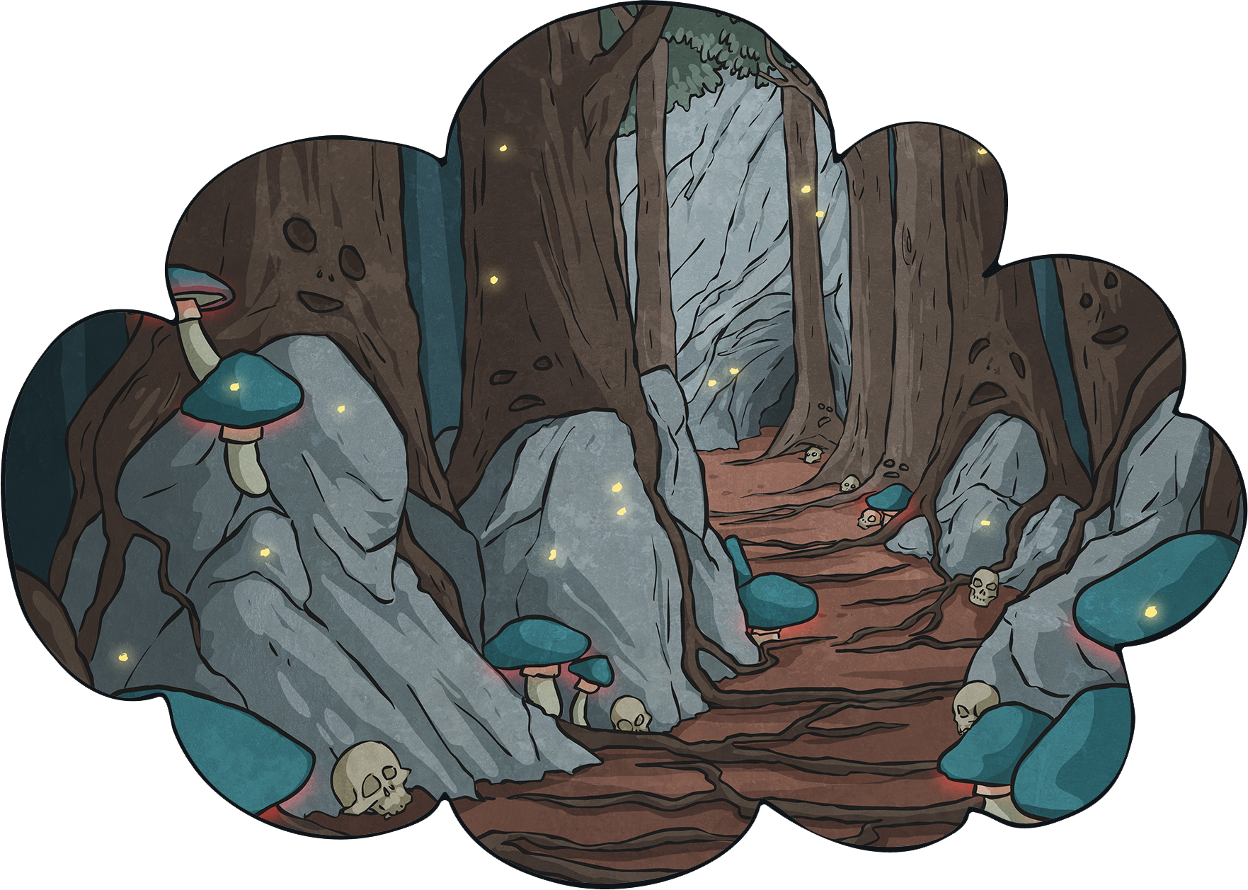
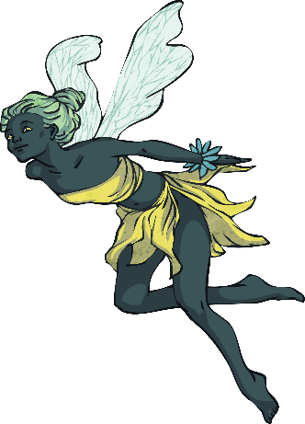
Why?
Why do we use similes and adjectives?
When you are describing something, you are trying to create a picture in the reader’s mind. Similes can help you to do this.
They are most often used in stories and poems.

Slide 5
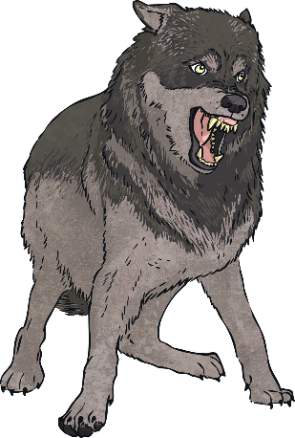
See How It Works
Why do we use similes and adjectives?
The dog was big and fierce.
Now if we add adjectives and similes…
The house was beautiful.
Now if we add adjectives and similes…
The ancient house was beautiful like an old fashioned painting.
The black, scruffy dog was as big as a wolf and fierce like a very angry bear.
Isn’t that better?

Slide 6
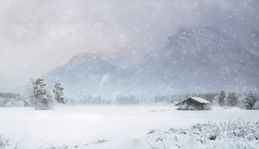
Winter Scene
Useful adjectives:
icy
cold
freezing
bitter
bleak
Useful nouns:
snowflakes
wind
crystals
ice
icicles
Here are 2 examples. Now think of your own similes to describe the cold.
as cold as ice crystals.
as bleak as a bitter wind.

Slide 7
Quiz!
Which of these words is an adjective?
A
B
jumping
palace
D
C
happily
amazing

Slide 8
Quiz!
Why do we use similes?
A
B
To make our writing sound good.
To create a picture for the reader.
C
D
Because we get a house point for it.
Because our teacher tells us to.

Slide 9
Quiz!
Which of these is a simile?
A
B
The moon was a pale, silver coin in the sky.
The sky was as blue as the sea.
C
D
The angry waves climbed the sea wall.
The howling, wolf-like baby was driving me mad.

Slide 10
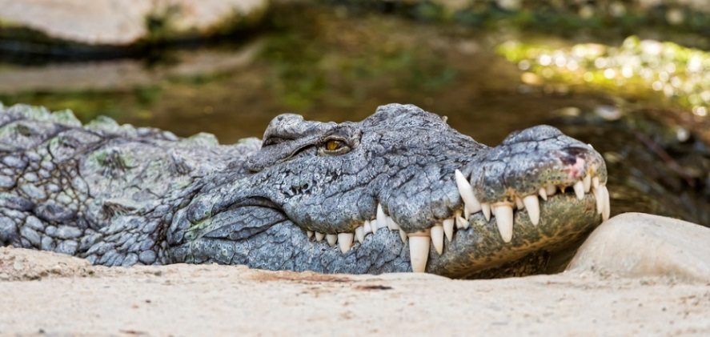
Quiz!
Pick the best adjective to describe the teeth in the picture. Give reasons.
A
B
nasty
razor-sharp
D
C
pointy
awful

