Slide 3
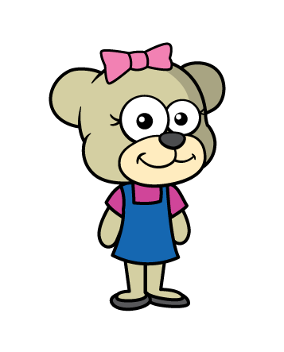
1) How many fingers?
2) How many eyes?
3) Which number is thirty? 13 30
4) Can you describe these two using the words taller and shorter?

Slide 4
1) How many fingers?
2) How many eyes?
3) Which number is thirty? 13 30
4) Can you describe these two using the words taller and shorter?
35
8

Slide 6
Let’s measure!
Have a think

Slide 7
How many long are these?
3
4
Have a think
2

Slide 8
Have a go at question 1 on the worksheet

Slide 9
What is the length of the ?
Have a think
6
I think it is 7
I think it is 6
Who is correct?

Slide 10
Have a go at question 2 on the worksheet

Slide 11
What is the length of the ?
Have a think
I think it is 6
I think it is 3
Who is correct?

Slide 12
Which is longer?
Have a think
This is 5
That means it is longer!
The shell is 4
Do you agree?

Slide 13
Have a go at questions 3 and 4 on the worksheet

