Slide 1


Slide 3
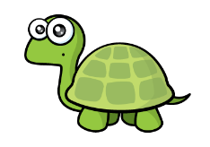
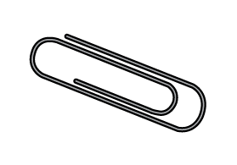
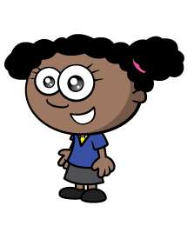
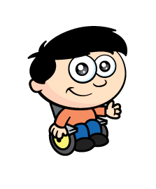
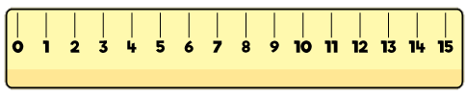
What can we use to measure?

Slide 4
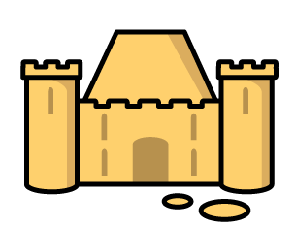
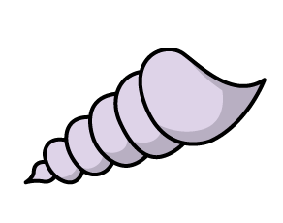
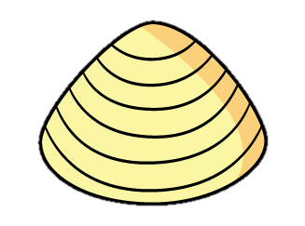
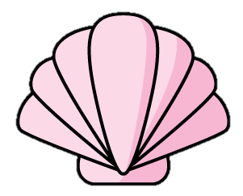
Why use a ruler?
?
?
?
The sandcastle is 4 shells long.
No confusion!

Slide 5


Why use a ruler?
Have a think
To measure and compare
different objects.

Slide 6
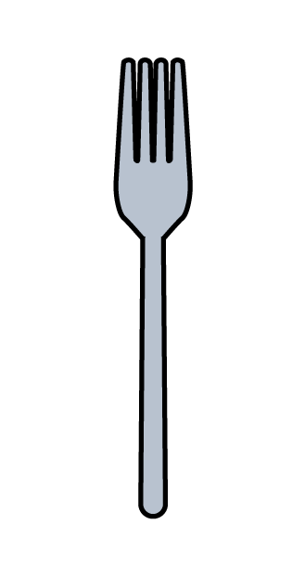
Why use a ruler?
Have a think
There are no spaces.

Slide 7
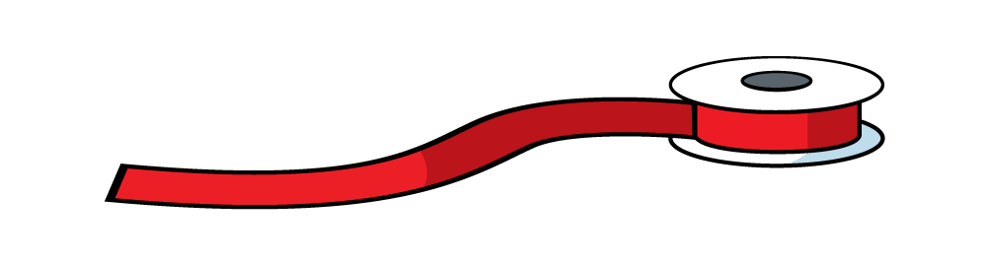
Why use a ruler?
Have a think
People talk about length using rulers.

Slide 8
Can you find a ruler?
What is the same? What is different?

Slide 9
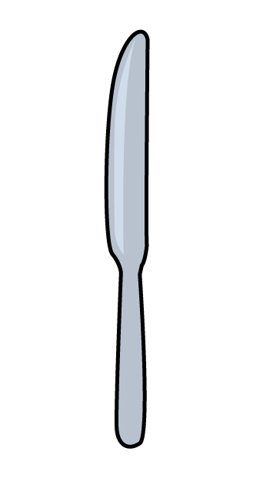
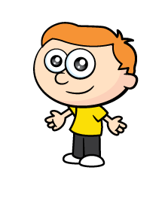
Be careful!
Have a think
Mind the gap!

Slide 10
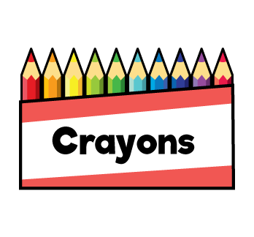
Where can you start?
Have a think
5
Any number!

Slide 11
Can you measure your crayons?

Slide 12
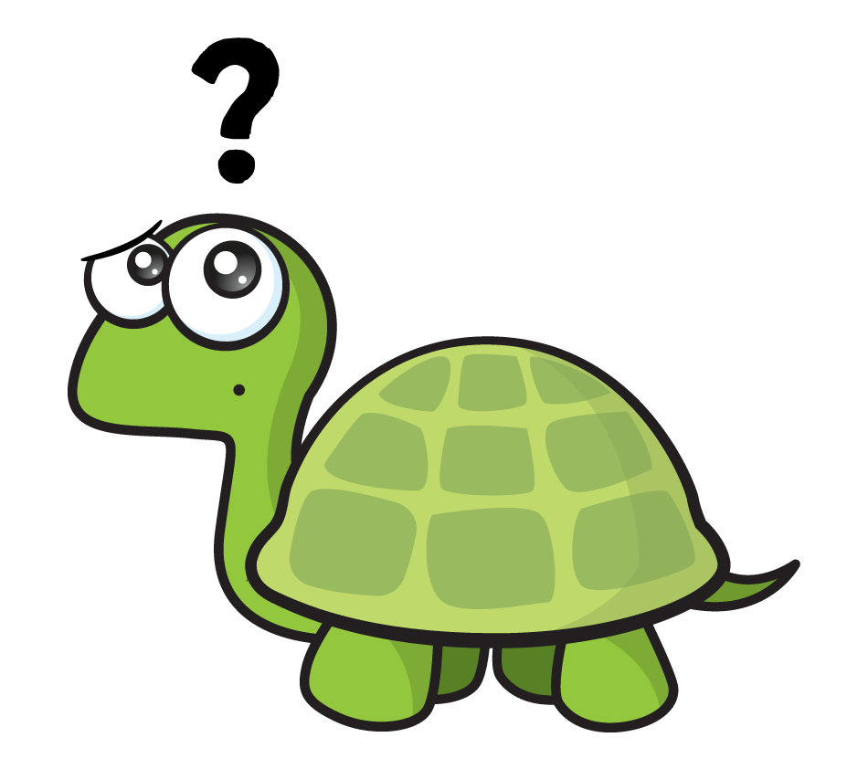
What if it isn’t perfect?
Have a think
Closest to…
Almost…

Slide 13
Can you measure your pencil?
Can you start from different spots?

