Slide 1



Slide 2
Why do we teach phonics?
All words are made of sounds, those sounds blend together to form words for example c- a –t, d-o-g
We use 44 sounds to make all the words in the English language however we only have 26 letters.
The 26 letters work singularly, in pairs (digraphs like sh, ch, th) and in threes (trigraphs like igh) to make one sound.
So ship has three sounds sh-i-p, and light also has three sounds
l-ight-t

Slide 3
Some of the sounds are spelt in more than one way.
For example the ‘s’ sound can be spelt in several different ways
s-i-t (one s)
d-r-e-ss (two s’)
h-o-r-se (se)
c-i-r-c-le (c)
p-ie-ce (ce)
This is why some children find learning to read tricky, as there are so many different ways of spelling the sounds.

Slide 4
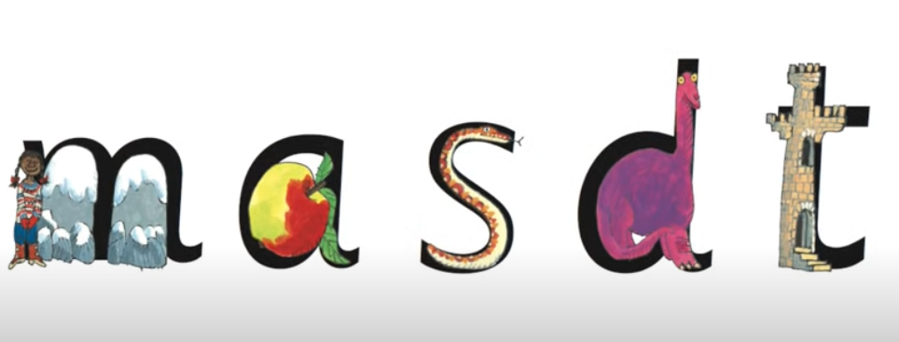
How does RWI phonics help your child to read?
The National Curriculum ensures that school teach children to read phonetically. It is up to individual schools to decide how they want to do it.
First, we teach children just one way of reading and spelling the English sounds.
We give children a tool to support them with learning the sounds which is a picture to match the letter.

Slide 5
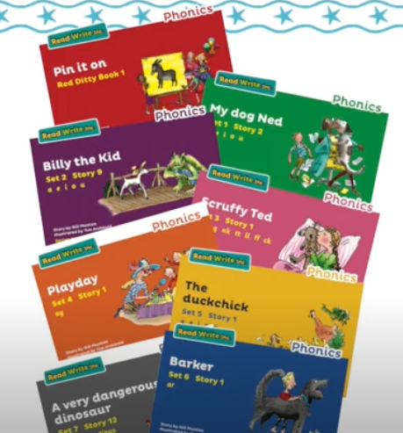
Following the teaching of the first set of sounds pupils are assessed and are given a book to match the sounds that they have been taught. These books have been sent home and will be changed by us each Thursday.

Slide 6
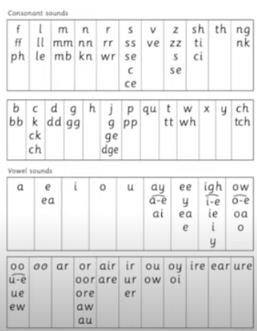
Once children can read those books confidently, we teach them more ways to spell the same sounds. The children are not given books that contain the spellings of the sounds that they do not know.

Slide 7
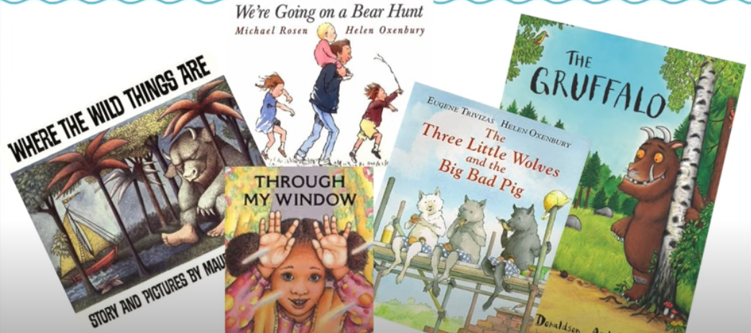
This means that children build up their confidence quickly as they have been taught all the sounds that are in their books. Our continuous assessments mean that the books that children receive to read are perfectly matched to their phonic ability.
We never ask children to guess words from pictures. We do, however, read a wide range of texts to children that include lots of words from the English language that they can’t read independently.
Our daily Book Talk sessions ensure that children develop a love of books, become familiar with the features of different texts and broaden their vocabulary.

Slide 8
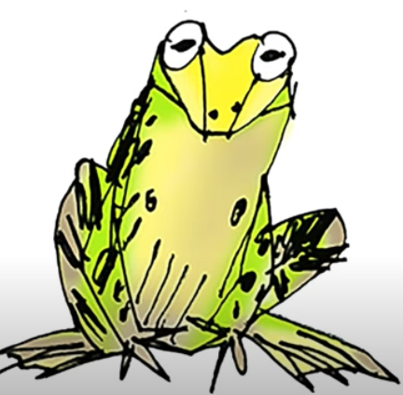
What is Fred talk?
We refer to the blending of sounds as ‘Fred Talk’. Fred is a frog who can only talk by segmenting (separating words into their individual sounds)
Children are ready to blend sounds together once they have learnt to read the first set of sounds at speed (m,a,s,d,t)

Slide 9
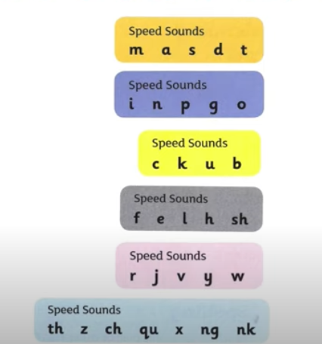
It can take some time to master blending, so don’t worry if your child doesn't understand this straight away. Continue to work on learning the sounds until they have mastered all of them.
To find out more about the correct pronunciation of sounds please use the Ruth Miskin tutorials on YouTube, or email us and we will send you the link.

Slide 10
How can I support my child at home?
Complete the weekly homework.
Read to your child daily.
Use the Read, Write, Inc phonics cards to support your children with retaining the sounds.
Watch the Ruth Miskin training videos on YouTube.
Email us if you need any help.

